Slide 1
PoC members and Blockchain Industrial subjects for whom will this architecture be suited for GreenBay Transfer GreenBay Donation CopyGate Volvo Group Trucks
IBM – HCL – BlueBarricade Blockchain Services Architecture

Slide 2
Activities to date (under the radar and without budget so far)
Discussions with IBM to understand IBM Blockchain Platform
Discussions with HCL Blockchain Team (D&A) to engage, align and collaborate
Discussions with Volvo Group IT CoE Blockchain team
Briefly explored open source Hyperledger on LinuxOne
Brief discussions with new clients (Skatteverket, Klarna, Spotify)

Slide 3
Blockchain in General

Slide 4
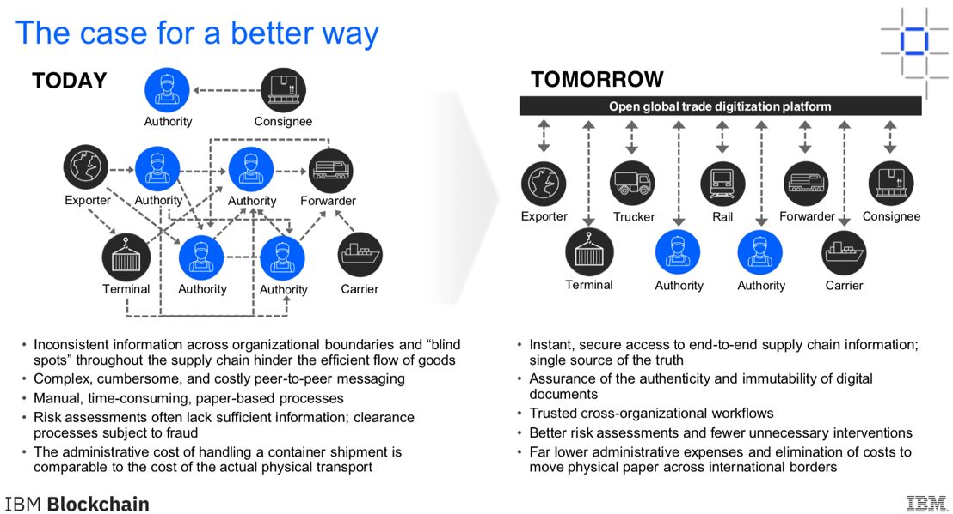
Blockchain Business Network: Tradelens in a conceptualize business flow by Maersk and IBM
Blockchain in General

Slide 5
Blockchain in General

Slide 6
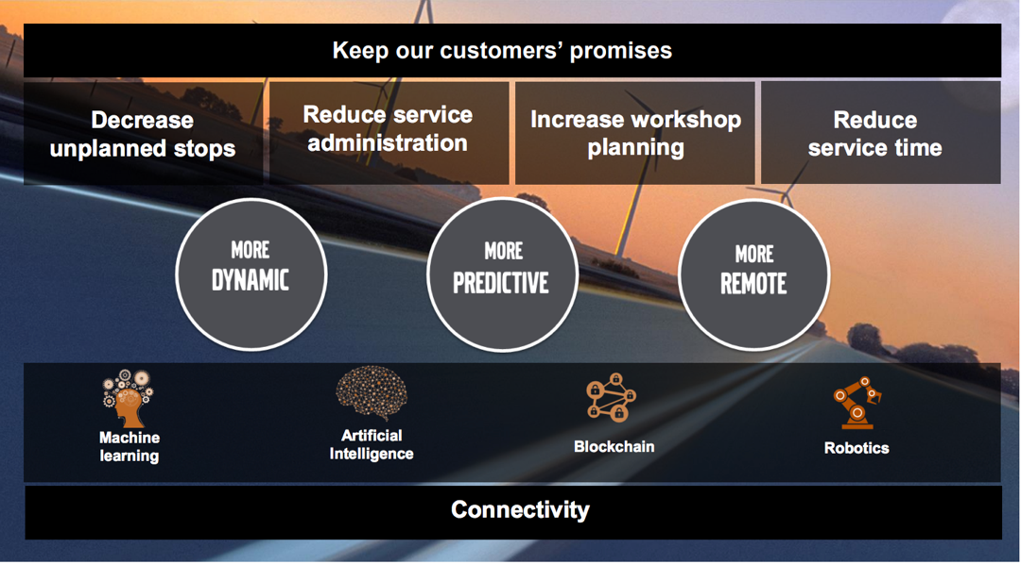
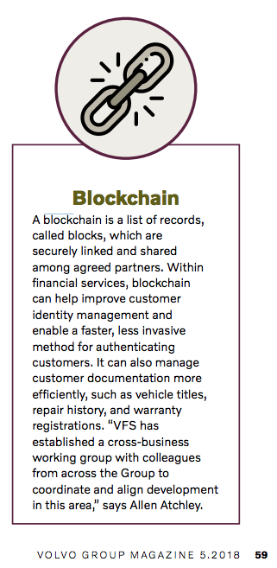
Volvo internals – Volvo Group Leadership Summit May 21-22 2019
Blockchain in General Use Case

Slide 7
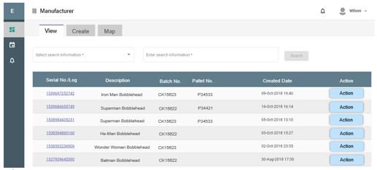
Volvo Group – First Proposal for Group IT CoE Blockchain team delivered
Set up Hyperledger on MS Azure
Deploy HCL demo application
Continuous technical support, 6m
Co-sell towards Volvo Group & partners
Use cases:
Vehicle Lifecycle Management
Materials tracking – Cobalt
Supply chain
Spare parts tracking
Finance

Slide 8


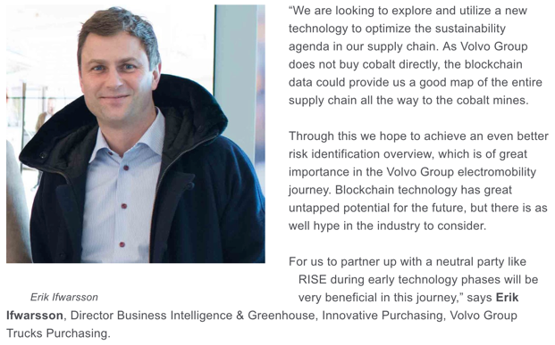
Volvo external communication (www.volvogroup.com web site)
Blockchain in General Use Case
Notes:
https://www.volvogroup.com/en-en/news/2019/jan/volvo-group-partners-with-research-institutes-of-sweden.html

Slide 9
Volvo internals – Volvo Magazine 2018

Slide 10
Clients: GreenBay Transfer GreenBay Donation CopyGate Volvo Group Trucks Volvo Group Cars
Parts
Infrastructure and Service: HCL GSS
system Software and Hardware: BlueBarricade IBM

Slide 11
Parts Overall Architecture and Infrastructure
HCL Infrastructure 90% on place for phase 1 ICP Cloud Pack ? Datapower Key products z/OS connect Open Shift and Blockchain 2.1 after summer
Network split from Volvo and adding new customer after summer
IBM Software and Hardware 90% place for phase 1 ICP Cloud Pack ? z/OS Linux
z/OS Mainframe Datapower Key products z/OS connect Open Shift and Blockchain 2.1 after summer
Network split from Volvo and adding new customer after summer
Open Source
Hyper ledger 1.4.3. Hyper ledger 1.4.4

Slide 12
Parts in BlueBarricade architecture system
BlueBarricade Infrastructure
BlueBarricade Blockchain server integration API Services BlueBarricade Blockchain cloud integration API Services BlueBarricade Explorer BlueBarricade Admin Tool Key Products: Hyper ledger 1.4.3
Hyper ledger 1.4.4 IBM Blockchain 2.1 open shift
IBM DB2
AWS (BlueBarricade Explorer)

Slide 13
Parts in External Customer architecture system
GreenBay Transfer and Donation Infrastructure
Greenbay IoT Client app and web
GreenBay Front End API Services
GreenBay Back End Services including Blockchain API
GreenBay Admin Tool Key Products: Hyper ledger 1.4.4 and IBM Blockchain 2.1 React Web React Native App IBM Cloud
IBM DB2

Slide 14
Parts in External Customer architecture system
CopyGate CopyGate IoT Client app and web
GreenBay Front End API Services
CopyGate Back End Services including Blockchain API
CopyGate Admin Tool Key Products: React Web React Native App Hyper ledger 1.4.4 and IBM Blockchain 2.1
IBM Cloud
IBM DB2

Slide 15
Parts in External Customer architecture system
Volvo Group Trucks
Volvo IoT Client app and web
GreenBay Front End API Services
GreenBay Back End Services including Blockchain API
GreenBay Admin Tool Key Products: React Web React Native App
IBM Cloud
IBM DB2

Slide 16
Cloud to Cloud and Cloud to On Prem perquisites and principles for total cost of owner ship
GSSH Ecosystem Key Requirements : Modern & Hybrid
_{Hybrid User Communities}
_{Citizen Integration ( IT LOB )}
_{Adhoc Integrators}
_{Integration Specialist}
_{Hybrid Integration Styles}
_{Event Integration}
_{DATA Integration}
_{API Integration}
Messaging
API Management
Integration
_{Hybrid Secure Connectivity}
_{Public – Private – OnPremise}
Connectivity between multiple messaging providers
_{Hybrid Deployment}
_{Flexible across any site}
_{In form of IAAS-PAAS-SAAS}
_{Multi-Tenant}
_{Scalability}

Slide 17
IBM – HCL – BlueBarricade Blockchain Services Architecture and Infrastructure in GSSD Futuristic Roadmap perquisites
Modern Infrastructure Services for IAAS and PAAS
Hybrid/Multi Cloud Strategy with Public/Private/Dedicated/On-Premise
DevOps Inspired Application Deliveries , Platforms & Frameworks
Automated Provisioning , Configuration and Deployment
Data Lake and Big-Data Analytics Platforms
Internet of Things and Connected Devices
Micro-Services Based Applications & Architecture
Multi-Tenant & Dedicated Models
Introduction of XAAS ( SX and XSM ) – Service Catalogue, Traceability of Consumption
Reduce dependency on Incumbent platforms for Modern & Digital applications
Services to be Agile , Scalable , Cross-Sites , API oriented & DR
Develop & Monetize API as Commercial Products for application/service for Internal/Partner/External usage
At same time Integrations to allow simplified flow/conversions between Legacy and Modern world & allow Citizen Integrators to develop simple-easy Integration workflows

Slide 18
STRATEGIC PRIORITY 4- SP4
These infrastructure requirements are foreseen as needed to support the new Volvo Group IT strategy and a new Hybrid Integration Reference architecture:
Enhanced capabilities supporting Integration Security
Integration capabilities supporting a Hybrid cloud setup (incl API management)
Integration capabilities supporting an IoT scenario
Integration capabilities supporting exchange of large data volumes, e.g. in BI
Enhanced traceability and E2E monitoring of information exchange
Integration capabilities supporting a Bimodal IT setup
Enhanced capabilities for mobile integrations
Enhanced Integration provisioning
Support for Integration testing

Slide 19

Complexity & Diversity in Messaging : Cloud with Enterprise
IBM – HCL – BlueBarricade Blockchain Services Architecture and Infrastructure in GSSD Futuristic Roadmap perquisites
AWS
B
I
G
D
A
T
A
Azure
Service Bus
APP
SQS
MQ
APP
MQ
S
A
A
S
APP
Cloud Native to MQ - Gateway
I
O
T
APP
APP
APP
Private
APP
R MQ
IBM Enterprise Service Bus - IIB + DataPower + MQ
On-Premise

Slide 20
GSSD Integration Services
IBM – HCL – BlueBarricade Blockchain Services Architecture and Infrastructure in GSSD Futuristic Roadmap perquisites
Current Offering :
Messaging Oriented Middleware
Point-Point
Publish-Subscribe
Request-Reply
Gateway
Messaging Gateways
HTTP to MQ (vice-versa)
Secure Web Service
Managed File Transfer
Support Industry Standard Protocols
Enterprise Service Bus
Routing & Transformation
Portals
Config Management Database
Request , Provisioning and Deployment
Self-Service & Administration
Monitoring & Logging
Security
Encryption
Authorization & Authentication
Next-Gen Offering :
Hybrid Cloud
Public Cloud Native messaging
Integration for modern Applications (IAAS / PAAS / SAAS ) and for micro-services
Integration Platform As A Service
Gateway
Send/Receive messages between Cloud Native & On-Premise Messaging Backbone
API Management
Manage / Monetize / Analytics / Products
Secure , Compose , Cache & Control API’s & Events
Portals
Service Catalogue
Centralized Governance
Developer Portal for API
Automated Provisioning and Configuration
Compliance & Data Protection
New Protocols
RESTFUL API’s
JSON

Slide 21
GreenBay System
Greenbaydonation.com
Greenbaytransfer.com
Greenbaypayment.com
Greenbayproject.com

Slide 22
GreenBay System
Greenbaydonation
Greenbaytransfer
Greenbayproject
www.greenbaydonation.com
www.greenbaytransfer.com
www.greenbayproject.com
admin.greenbaydonation.com
admin.greenbaytransfer.com
Greenbaypayment
GreenbayDonation
iOS/Android
GreenbayTransfer
iOS/Android
www.greenbaypayment.com
Greenbay Backend
EWallet Backend
Blockchain Service

Slide 23
GreenbayDonation
S/W Architecture
App
Web
Backend API
DB Server
Greenbay Features
Front Web
(React JS)
APIs
IBM DB2
Framework
Views/Components/Actions/
Services/APis
Node + Express Microservice
Admin Panel
(Laravel)
File Storage
(AWS S3 storage)
React Native
Redux/Flex Route
iOS/Androd
Ewallet API
APIs
Node + Express Microservice
Paypal
Stripe
Sendgrid
Onesignal
Twilio

Slide 24
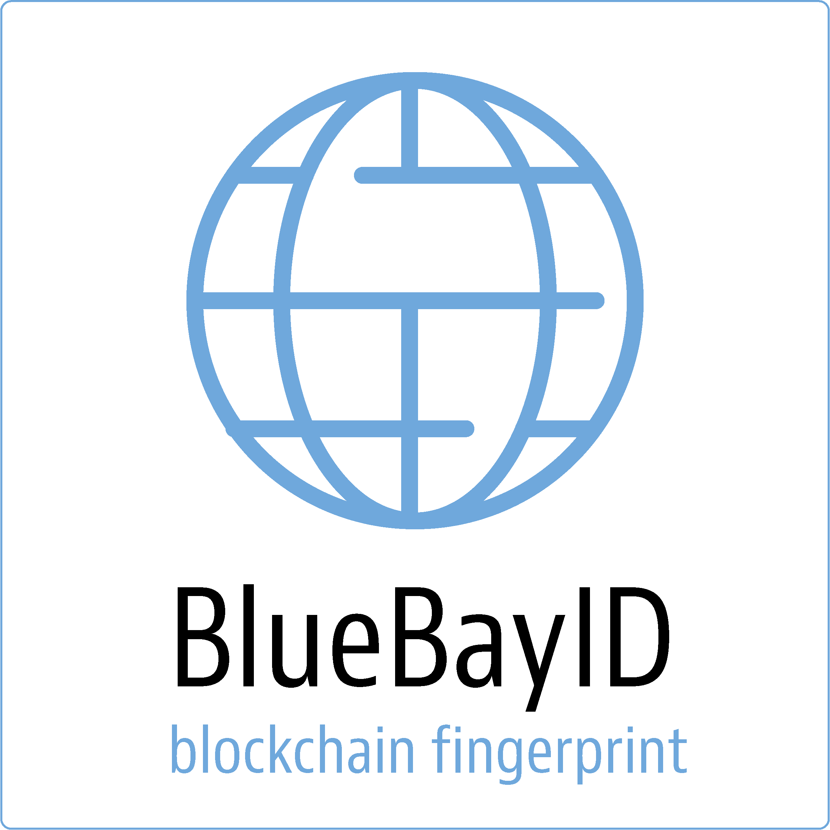
GreenbayDonation
H/W Architecture
App Cloud
AWS
IBM Cloud
Greenbay iOS
App Store
Amazon EC2
Front Web
(www.greenbaydonation.com)
IBM DB2
Amazon EC2
Admin Panel
(admin.greenbaydonation.com)
Greenbay Backend
IBM Cluster
Greenbay Android
Google Store
Amazon S3
Blockchain Explorer
(bluebarricade-blockchain-explorer.s3-website.us-east-2.amazonaws.com)
EWallet
IBM Cluster
Amazon S3 Storage
Blockchain Service
Paypal
Stripe
Sendgrid
Onesignal
Twilio

Slide 25
GreenbayTransfer
S/W Architecture
App
Web
Backend API
DB Server
Greenbay Features
Front Web
(React JS)
APIs
IBM DB2
Framework
Views/Components/Actions/
Services/APis
Node + Express Microservice
Admin Panel
(Laravel)
File Storage
(AWS S3 storage)
React Native
Redux/Flex Route
iOS/Androd
EWallet API
APIs
Node + Express Microservice
Paypal
Stripe
Sendgrid
Onesignal
Twilio

Slide 26
GreenBayTransfer
H/W Architecture
App Cloud
AWS
HCL Cloud
Greenbay iOS
App Store
Amazon EC2
Front Web
(www.greenbaytransfer.com)
DB2
Amazon EC2
Admin Panel
(admin.greenbaytransfer.com)
Greenbay Backend
Greenbay Android
Google Store
Amazon S3
Blockchain Explorer
(bluebarricade-blockchain-explorer.s3-website.us-east-2.amazonaws.com)
Ewallet Backend
Amazon S3 Storage
Blockchain Service
Paypal
Stripe
Sendgrid
Onesignal
Twilio

Slide 27
Music
S/W Architecture
Database
App
Web
API(Backend)
Redis
Server
WebStamp
(React JS)
Commons
Auth/Sockets/Files/Utils
Commons
Auth/Sockets/Files/Utils
Commons
Auth/Sockets/Files/Utils
Modules
Giveback/Donation/E-Wallet/
WebStamp/Greets/
Streaming Chat/Games
Commons
Auth/Sockets/Files/Utils
Modules
Giveback/Donation/E-Wallet/
WebStamp/Greets/
Streaming Chat/Games
Cloud
File Storage
Homepage
(Wordpress/React JS)
Commons
Auth/Sockets/Files/Utils
3rd Party
Payment Gateways
(paypal/stripe etc)
Framework
Views/Components/Actions/
Services/APis
MongoDB
React Native
Redux/Flex Route
JWT Auth
Mongoose
Admin Panel
(React JS)
Stream Server
iOS/Androd
NodeJS+Express
(Microservice architecture)
SRS/Nginx
Paypal
Stripe
ApplePay
Twitter
Facebook
Mailgun
Wexin
Alipay
GooglePay
Youtube
Twitch
Twillio

Slide 28
EzBoz
H/W Architecture
EsBoz iOS
App Store
Amazon EC2
Backend/Admin Panel
Mongo DB/Redis
Amazon S3
(Cloud Storage/
Static Websites)
Amazon EC2
Home Page/WebStamp
EsBoz Android
Google Store
Amazon EC2
Video Streaming Server
Paypal
Stripe
ApplePay
Twitter
Facebook
Mailgun
Wexin
Alipay
GooglePay
Youtube
Twitch
Twillio

Slide 29
BlueBarricade
S/W Architecture
Applications
Backends
Chaincode
Blockchain
Client Mobile App
(IOS/Android)
React Native,….
Backend
Golang/Nodejs
Smart Contract
(Chain Code)
Golang/Nodejs
Hyperledger fabric
v1.3
Client Web App
ReactJS,….
Packager Docker, Kubernates
Third party services

Slide 30
BlueBarricade
H/W Architecture
Client App
(ios/android)
App Store, Google store
Backend System
IBM Cloud Bluemix
Blockchain
(Hyperledger fabric)
IBM Cloud Bluemix
OR
OR
Client Web Platform
Amazon / IBM Cloud
Backend System
Amazon EC2
Blockchain
(Hyperledger fabric)
IBM Linuxone Clould
Third party services

Slide 31
GBB
John Back David UI
AS-IS
Peer To Peer
GBB
John Back David UI
XXX = Confidential Data
Identification managment
Token ID?= and Transaction Id=?
UI
UI
Backend
Transaction ID move to Greenbay Blockchain for
1. Identification,
2. Customer Role management
Greenbay Store
Telephone number
Email
Login
Passworrd.
Payment information pass to Bluebarricade
IBM Greenbay Private Cloud
Telephonnumber
Email
Login
Password
TO-BE Blockchain Hybrid Blockchain infrastucture
Open Private customer cloud (IBM, AWE, Azure, e.tc
DB2
2. Role Managment Perissions based
GSW Admin John and David
Copy GSW TIAN and Jacky
BBB
Customer Api IBM Li
HCL
FireWall
On Prem integration layer behind firewall HCL IBM Datapower
DMZ Zone
IBM Datapower
BBB Blockchain
On Prem API HU
3 Transsaction comittan and mathcn transaction sync
TO-BE Blockchain Hybrid Blockchain infrastucture
On Prem x86, Z/Linux and Z/OS DB2
Trusted and Restricted Zone
4 Transsaction security
Hyper ledger Native 1.4
IBM Hyperledger 1.4
Cics,
Ims
Cobol
PL/1
Mainframe Transactions SDK
Ogigal payment DB2 information
Volvo
IBM
5 Data integrity ON prem sort original data for GOV Audit

Slide 32
HCL GSS Blockchain for Business as a Service - High level architecture overview
Company X business process
Company Y business process
Company Z business process
REST/JSON, WS/XML, MQ
HCL GSS Blockchain Business API
Firewall
DataPower – Docker
Firewall
HCL GSS Hybrid Cloud
IBM Blockchain Platform
on
LinuxONE
HCL GSS Z Mainframe
IBM Blockchain Platform
on
Linux VM:s
DB
DB
z/OS Connect

Slide 33
HCL GSS Services – From a Developer’s perspective
Business requirements input
Chatbot as 1st level support, guidande on config etc.
Protection
Security / Perimeter protection (Firewalls, Datapower, Monitoring, Billing)
Portal
API Layer (API Platform, API Developer Portal, Monitoring, Billing)
Block- chain
Machine Learning
Data Lake
Cyber Security
Container
Web App
SQL & NoSQL database
DevOps
RPA
Services
x86 Hybrid Cloud
Z
Power
…
Infra
Compute
Storage

Slide 34
HCL GSS Blockchain for Business as a Service - Teams interactions
Existing & New/NN
Clients
HCL GSS CDO Org
HCL Blockchain team
(Digital & Analytics)
Public Cloud
GSS Integration
GSS On-prem Infra
MS Azure
AWS
Google Cloud
IBM *
Implementation of platform
Blockchain consulting
Application development
Applications & systems integrations
On-prem hosting &
Operations
X86 hybrid cloud
Z (LinuxOne, ZOS)
Cloud operations

Slide 35
Blockchain Client SDK
Purpose
To provide our blockchain service quickly and easily to other clients.
Features
Supports many development platforms
Java, Nodejs, golang, erlang etc
Easy to integrate
Supports most of cloud platforms
IBM, AWS, Azure, Google, Alibaba etc

Slide 36
How does it work
There are 2 ways to integrate Blockchain client SDK.
Source level integration
Cloud deployment and usage
Bluebarricade Platform
Client Source
(Java, golang,
nodejs or erlang)
Blockchain Client SDK
Bluebarricade
Blockchain
Server API
Blockchain
Service

Slide 37
How does it work
There are 2 ways to integrate Blockchain client SDK.
Source level integration
Cloud deployment and usage
Cloud Platform
(IBM, AWS, Azure,Google, Alibaba)
Blockchain Client SDK
Bluebarricade Platform
Client System
Bluebarricade
Blockchain
Server API
Blockchain
Service

Slide 38








Deployment using Kubernetes
Bluebarricade
Client API Service
Bluebarricade
Client API Service
Bluebarricade
Client API Service
Bluebarricade
Client API Service
Bluebarricade
Client API Service
Bluebarricade
Client API Service
Build &
Deploy
Bluebarricade/javaclientsdk
Bluebarricade/javaclientsdk
Bluebarricade/erlangclientsdk
Bluebarricade/erlangclientsdk
Bluebarricade
Client API Service
Bluebarricade
Client API Service
Bluebarricade
Client API Service
Bluebarricade/nodejsclientsdk
Bluebarricade/nodejsclientsdk
Bluebarricade/golangclientsdk
Bluebarricade/golangclientsdk
Bluebarricade
Client API Service
Bluebarricade
Client API Service
Bluebarricade
Client API Service
Bluebarricade
Client API Service
Bluebarricade
Client API Service
Bluebarricade
Client API Service

Slide 39
HCL Test Network(Current Platform)
Greenbay
App
(iOS/Android)
HCL Network
3rd party
Bluebarricade
Blockchain
(IBM)
Paypal
:3000
AWS
Stripe
Bluebarricade
Blockchain
Explorer
(AWS)
HCL
Firewall
E-Wallet
Backend
(HCL)
Greenbay
Web
(AWS)
E-Wallet
Database
(DB2)
Mail
Sendgrid
153.112.160.162
SMS
Greenbay
Backend
(HCL)
Twilio
Greenbay
Admin Panel
(AWS)
:80/443
Greenbay
Database
(DB2)
Notification
Onesignal

Slide 40
HCL Test Network(Current Platform)
Node | Location | OS | Technique
Greenbay Backend Server | HCL | Linux s390x | NodeJs/Express
Ewallet Server | HCL | Linux s390x | NodeJs/Express
Greenbay DB | HCL | Linux s390x | DB2
Ewallet DB | HCL | Linux s390x | DB2
Bluebarricade Server | HCL | Linux s390x | Hyperledger Febric
Greenbay Web | AWS | Ubuntu 18.x | ReactJS/Redux
Greenbay Mobile App | Google Cloud Apple Cloud | Android iOS | React-Native
Greenbay Admin | AWS | Ubuntu 18.x | Laravel 5.6, php7
Bluebarricade Explorer | AWS | Ubuntu 18.x | VueJS

Slide 41
IBM Network(Old platform)
Greenbay
App
(iOS/Android)
IBM Cloud
3rd party
Bluebarricade
Blockchain
(IBM)
Paypal
AWS
Stripe
Bluebarricade
Blockchain
Explorer
(AWS)
E-Wallet
Backend
(IBM)
E-Wallet
Database
(DB2)
:50000
Greenbay
Web
(AWS)
Mail
Sendgrid
IBM
Greenbay
Backend
(IBM)
:80/443
SMS
Twilio
Greenbay
Admin Panel
(AWS)
Greenbay
Database
(DB2)
Notification
Onesignal
:50000

Slide 42
IBM Network(Old Platform)
Node | Location | OS | Technique
Greenbay Backend Server | IBM Cloud | Ubuntu 16 | NodeJs/Express
Ewallet Server | IBM Cloud | Ubuntu 16 | NodeJs/Express
Greenbay DB | IBM Cloud |  | DB2
Ewallet DB | IBM Cloud |  | DB2
Bluebarricade Server | IBM Cloud |  | Hyperledger Febric
Greenbay Web | AWS | Ubuntu 18.x | ReactJS/Redux
Greenbay Mobile App | Google Cloud Apple Cloud | Android iOS | React-Native
Greenbay Admin | AWS | Ubuntu 18.x | Laravel 5.6, php7
Bluebarricade Explorer | AWS | Ubuntu 18.x | VueJS

Slide 43
Greenbay Transfer Money Workflow
Payment
System
(Paypal, Stripe)
6. Deposit money
14. Withdraw money
1. Register user
Greenbay
Mobile/Web
E-Wallet
System
Bluebarricade
Blockchain
(IBM)
2. Create user wallet
3. Create blockchain address
A
P
I
4. Deposit money
5. Deposit money
7. Save Deposit Tx
8. Find a receiver
10. Send money
11. Save Send Tx
9. Send money to receiver
13. Send money
12. Withdrawal money
14. Save Withdrawal Tx
Composer rest api
User Data
Friend
Family
Wallet Address
Transactions
- TxID
- BC TX
Wallet
- Address
- BC Address
- Currency
- Balance
Transactions
- TxID
- BC TX
Address
- Address ID
- Currency
- Balance
Transactions
- Tx ID
- Tx Detail

Slide 44
Donation
Greenbay
Mobile/Web
2. Create project wallet
E-Wallet
System
Bluebarricade
Blockchain
1. Create project
3. Create blockchain address
6. Lock Balance(User)
8. Save Send Tx
4. Find a project
7. Lock Balance(Project)
5. Donate!
10. Save Commit Tx
9. Commit project Lock
11. Rollback project Lock
12. Save Rollback Tx
Donation Project
- Wallet Address
Currency
Target Amount
Deadline
Balance
Status
User Wallet
- Address
- BC Address
- Currency
- Lock Balance
Transactions
- TxID
- BC TX
Project Wallet
- Address
- BC Address
- Balance
- Lock Balance
Address
- Address ID
- Currency
- Balance
Transactions
- Tx ID
- Tx Detail
User Wallet
- Address
- BC Address
- Currency
- Lock Balance
Transactions
- TxID
- BC TX
User Wallet
- Address
BC Address
Balance
- Lock Balance
Transactions
- TxID
- BC TX
Project Wallet
User Wallet
Locked
Balance
when donation
is success
Real
Balance
Withdraw by
project owner
for donation business
Donation
User Wallet
User Wallet
when donation
is failed

Slide 45
Greenbay Donation Summary
User Wallet
Project Wallet
User Wallet 1
Locked
Balance
Donation
Withdraw by
project owner
for donation business
User Wallet 2
when donation
is success
when donation
is failed
User Wallet 3
Real
Balance

Slide 46
Donation Logic Flow
Greenbay
Mobile/Web
2. Create project wallet
E-Wallet
System
Bluebarricade
Blockchain
1. Create project
3. Create blockchain address
6. Lock Balance(User)
8. Save Send Tx
4. Find a project
7. Lock Balance(Project)
5. Donate!
10. Save Commit Tx
9. Commit project Lock
11. Rollback project Lock
12. Save Rollback Tx
Donation Project
- Wallet Address
Currency
Target Amount
Deadline
Balance
Status
User Wallet
- Address
- BC Address
- Currency
- Lock Balance
Transactions
- TxID
- BC TX
Project Wallet
- Address
- BC Address
- Balance
- Lock Balance
Address
- Address ID
- Currency
- Balance
Transactions
- Tx ID
- Tx Detail
User Wallet
- Address
- BC Address
- Currency
- Lock Balance
Transactions
- TxID
- BC TX
User Wallet
- Address
BC Address
Balance
- Lock Balance
Transactions
- TxID
- BC TX

Slide 47
GSS Business model - draft
Blockchain is a new middleware (“similar to a database”) to store & replicate transactions
Sell as a service
Interface with the service through an API (transactions) & web portal (admin)
Charged on a per-transaction model
Possibly a monthly fixed cost, plus staircase/packaging of x number of transactions per day/month
Number of business networks, nodes, channels etc.
NOT as traditional CPU/memory/disk
Add integration services and other Blockchain-specific consulting services to increase margins and move up the value chain

Slide 48
What’s in it for HCL GSS?
Increase business
Z and hybrid cloud workload (the Z is a great Blockchain runtime)
Integration
Blockchain consulting (architecture, smart contracts development, business process integration consulting)
Apps, Digital and Analytics consulting
Attract completely new clients
Drive HCL corporate Mode 2 themes
Digital transformation
Digital native-ness
Ecosystems
Customer experience
Proactiveness – get ahead of the competition on the market with a viable & feasible solution

Slide 49
Status as of today – Volvo CoE case
Delivered proposal to Volvo CoE, received feedback, revised proposal and effort estimate, resent to Volvo.
Got accept from Volvo week 26. Work to start as we speak.
Volvo CoE are (actively) pushing for Blockchain towards Volvo business – workshops, meetings etc.

Slide 50
Greenbay P&DT (Financial sector) – New client (NN)
Customer Name | Greenbay P&DT UK LTD
Industry | Financial money Transfers and Donations
Contact person | James Savage, CEO
Background | Greenbay is a digital cross border money wiretransfer company (similar to Western Union and MoneyGram). It will relay on a EU financial institution E-money mobile licence. On 23rd January 2017 the EU Commission issued the “Commission Initiative Roadmap” for 2018 regarding the intensified battle against the financing of terrorism, also known as the ‘Payments Restriction Initiative’. To comply with this initiative Greenbay needs to develop a solution to solve cross-border transactions while at the same time prevent money laundry and terror financing via KCY/AML.
Use case | GreenBay will have a both have a Greenbay world wide global e-Wallet as well as customer branded e-Wallets for its partners, such as Telecom operators, provided as a service for their clients (similar to Hallon.se in Sweden). Due to new global directives (above) Greenbay looks at using Blockchain with their current e-Wallet solution to achive necessary transaction governance traceability.
Complexity | Relatively simple
Chances to win | High
Next steps | Define PoC scope and goal, send proposal, sign agreement with client.
Revenue at next step | 30K€, start July 1
Total Contract Value | TBD
Architecture/Components | Customer NodeJS REST Call from IBM Private Cloud to a permissioned Blockchain. Update public Blockchain with ref and on-prem permissioned Hyperledger Blockchain store ledger transaction in a DB2 database in secured and restricted zones at HCL.

Slide 51
Greenbay P&DT Blockchain PoC overview
Greenbay internal DC
IBM Private Cloud
Test application
REST/JSON, WS/XML
HCL GSS Blockchain Business API
Internet
Firewall
DataPower
HCL GSS DMZ
Firewall
HCL GSS Trusted
Blockchain
on
LinuxONE
HCL GSS Z mainframe
DB2
z/OS Connect

Slide 52
High level POC architecture, Linux one view - DRAFT
Test app
Internet
REST API
Firewall
DataPower
HCL GSS DMZ
Firewall
HCL GSS Trusted
z/VM (host)
Physical switch
Virtual switch
Replication?
DB
Current network zone: Volvo_IT_Application_GOT, EBN
Not OK
Linux RedHat 7
Vlan 3328 153.112.160.162
CouchDB
Off-chain
DB2/ZOS
Docker with HyperLedger 1.4 and CouchDB
LinuxOne

Slide 53
BlueBarricade Blockchain API and Configuration

Slide 54





Environment 1. (with HCL servers)
Cloud
Front
Backend
Blockchain
AWS-Server1 (Greenbay Frontend)
HCL-Server4 (Greenbay Backend)
Linux-s390x
DB2
HTTP: 80/443
HTTP: 80/443
TCP/IP port:50000
Ubuntu 18.04
AWS-Server2 (Greenbay Admin)
HTTP: 80/443
HCL-Server5 (Ewallet Backend)
HCL-Server6 (Bluebarricade blockchain)
Thirdparty services
HTTP: 80/443
Ubuntu 18.04
DB2
HTTP: 3000
TCP/IP port:50000
AWS-Server3 (Blockchain Explorer)
Linux-s390x
HTTP: 3000
Linux-s390x
HTTP: 80/443
Ubuntu 18.04

Slide 55
Environment 2. (with IBM starter plan)
Cloud
Front
Backend
Blockchain
IBM Cloud (Greenbay Backend)
AWS-Server1 (Greenbay Frontend)
DB2
IBM Blockchain Starter plan
(bluebarricade network)
HTTP: 80/443
HTTP: 80/443
TCP/IP port:50000
Ubuntu 18.04
AWS-Server2 (Greenbay Admin)
HTTP: 80/443
IBM Cloud (Ewallet Backend)
HTTP: 80/443
Blockchain API Sever
(composer rest api)
IBM Cloud Foundary app
Thirdparty services
Ubuntu 18.04
HTTP: 3000
AWS-Server3 (Blockchain Explorer)
DB2
TCP/IP port:50000
HTTP: 3000
HTTP: 80/443
Ubuntu 18.04

Slide 56
Challenge
HCL GSS DMZ and HCL GSS Trusted zones do not exist today
Awaiting the Segregation project – what is status?
We do not want to run this POC using Volvo’s DMZ or Trusted zone

Slide 57
Greenbay PoC plan
Pre-study
PoC
GoToMarket
Contract
Mid August
Network architecture & Segregation
Systems architecture to support:
Match transaction commits
Traceability
Data integrity
Blockchain architecture
API design
IBM Blockchain vs OSS Blockchain
Technical capabilities on Z
LinuxOne vs ZOS
Cost
Support 24x7
Service description
Build POC environment
Validate end-to-end scenario
Performance & capacity analysis
Price model
Sales material

Slide 58
GSS resources
Project Manager
Architects
Network
Blockchain (source from HCL Blockchain team)
Service Lead

Slide 59
Deployment options
Azure
AWS
IBM Cloud
Client’s internal DC
REST/JSON, WS/XML
HCL GSS Blockchain Business API
Internet
Firewall
DataPower
DMZ
Firewall
HCL GSS
Blockchain
on
LinuxONE
HCL GSS Z mainframe
Blockchain
on
zOS
HCL GSS x86:
Oden Hybrid Cloud
Hybrid cloud
Traditional VMs
Blockchain
on
Linux x86 VM:s
Blockchain
on
OpenShift
DB
DB
DB
z/OS Connect

Slide 60
Bluebarricade REST API
HYPERLEGER FABRIC 1.4.3
HYPERLEDGER COMPOSER
IBM BLOCKCHAIN PLATFORM

Slide 61
BlueBarricade Blockchain API and Configuration
(Greenbay&Bluebarricade)

Slide 62
Overview
J2EE Spring based REST API for Bluebarricade Blockchain Service
Version information
Version : 1.0.0
Contact information
Contact : Mikael Bramstedt
Contact Email : mikael.bramstedt@bluebaricade.com
License information
License : Apache 2.0
License URL : http://www.apache.org/licenses/LICENSE-2.0.html
Terms of service : null
URI scheme
Host : localhost:8080
BasePath : /
Tags
Address : REST API for Address
Deposit : REST API for Deposit
LockBalance : REST API for LockBalance
Transfer : REST API for Transfer
UnlockBalance : REST API for UnlockBalance
Withdraw : REST API for Withdraw
Paths
getAddress
GET /v1/addresses/{address}
1

Slide 63
Parameters
Type | Name | Description | Schema
Path | address required | address | string
Responses
HTTP Code | Description | Schema
200 | OK | Address
401 | Unauthorized | No Content
403 | Forbidden | No Content
404 | Not Found | No Content
Produces
application/json
Tags
Address
getDeposits
GET /v1/deposits
Responses
HTTP Code | Description | Schema
200 | OK | < Deposit > array
401 | Unauthorized | No Content
403 | Forbidden | No Content
404 | Not Found | No Content
2

Slide 64
Produces
application/json
Tags
Deposit
getDeposit
GET /v1/deposits/{transactionId}
Parameters
Type | Name | Description | Schema
Path | transactionId required | transactionId | string
Responses
HTTP Code | Description | Schema
200 | OK | Deposit
401 | Unauthorized | No Content
403 | Forbidden | No Content
404 | Not Found | No Content
Produces
application/json
Tags
Deposit
getLockBalances
GET /v1/lockbalances
3

Slide 65
Responses
HTTP Code | Description | Schema
200 | OK | < LockBalance > array
401 | Unauthorized | No Content
403 | Forbidden | No Content
404 | Not Found | No Content
Produces
application/json
Tags
LockBalance
getLockBalance
GET /v1/lockbalances/{transactionId}
Parameters
Type | Name | Description | Schema
Path | transactionId required | transactionId | string
Responses
HTTP Code | Description | Schema
200 | OK | LockBalance
401 | Unauthorized | No Content
403 | Forbidden | No Content
404 | Not Found | No Content
4

Slide 66
Produces
application/json
Tags
LockBalance
getTransfers
GET /v1/transfers
Responses
HTTP Code | Description | Schema
200 | OK | < Transfer > array
401 | Unauthorized | No Content
403 | Forbidden | No Content
404 | Not Found | No Content
Produces
application/json
Tags
Transfer
getTransfer
GET /v1/transfers/{transactionId}
Parameters
Type | Name | Description | Schema
Path | transactionId required | transactionId | string
5

Slide 67
Responses
HTTP Code | Description | Schema
200 | OK | Transfer
401 | Unauthorized | No Content
403 | Forbidden | No Content
404 | Not Found | No Content
Produces
application/json
Tags
Transfer
getUnlockBalances
GET /v1/unlockbalances
Responses
HTTP Code | Description | Schema
200 | OK | < UnlockBalance > array
401 | Unauthorized | No Content
403 | Forbidden | No Content
404 | Not Found | No Content
Produces
application/json
Tags
UnlockBalance
6

Slide 68
getUnlockBalance
GET /v1/unlockbalances/{transactionId}
Parameters
Type | Name | Description | Schema
Path | transactionId required | transactionId | string
Responses
HTTP Code | Description | Schema
200 | OK | UnlockBalance
401 | Unauthorized | No Content
403 | Forbidden | No Content
404 | Not Found | No Content
Produces
application/json
Tags
UnlockBalance
getWithdraws
GET /v1/withdraws
Responses
HTTP Code | Description | Schema
200 | OK | < Withdraw > array
7

Slide 69
HTTP Code | Description | Schema
401 | Unauthorized | No Content
403 | Forbidden | No Content
404 | Not Found | No Content
Produces
application/json
Tags
Withdraw
getWithdraw
GET /v1/withdraws/{transactionId}
Parameters
Type | Name | Description | Schema
Path | transactionId required | transactionId | string
Responses
HTTP Code | Description | Schema
200 | OK | Withdraw
401 | Unauthorized | No Content
403 | Forbidden | No Content
404 | Not Found | No Content
Produces
application/json
8

Slide 70
Tags
Withdraw
Definitions
Address
Name | Description | Schema
address optional | Wallet address | string
available_bala nce optional | Amount of wallet Example : 10.5 | number (float)
currency optional | Currency Example : "USD" | string
lock_balance optional | Locked amount of wallet Example : 10.5 | number (float)
Deposit
Name | Description | Schema
deposit_amou nt optional | Amount to deposit Example : 10.5 | number (float)
timestamp optional | Timestamp when deposit requested | string (date-time)
to_address optional | Wallet address to deposit | string
transactionId optional | Transaction ID | string
LockBalance
9

Slide 71
Name | Description | Schema
address optional | Wallet address | string
lock_amount optional | Amount to lock Example : 10.5 | number (float)
timestamp optional | Timestamp when lock requested | string (date-time)
transactionId optional | Transaction ID | string
Transfer
Name | Description | Schema
from optional | Sender wallet address | string
receive_amou nt optional | Receive amount | number (float)
send_amount optional | Send amount | number (float)
timestamp optional | Timestamp when transfer requested | string (date-time)
to optional | Receiver wallet address | string
transactionId optional | Transaction ID | string
withdraw_am ount optional | Withdrawal amount | number (float)
UnlockBalance
10

Slide 72
Name | Description | Schema
address optional | Wallet address | string
timestamp optional | Timestamp when unlock requested | string (date-time)
transactionId optional | Transaction ID | string
unlock_amou nt optional | Amount to unlock | number (float)
Withdraw
Name | Description | Schema
from_address optional | Wallet address | string
timestamp optional | Timestamp when withdraw requested | string (date-time)
transactionId optional | Transaction ID | string
withdraw_am ount optional | Amount to withdraw | number (float)
11

Slide 73
BlueBarricade Blockchain API and Configuration
(Greenbay&Bluebarricade)

Slide 74
Methods For connection with Bluebarricade Poc blockchain
BBB/javaclientsdk
BBB /nodejsclientsdk
BBB /golangclientsdk
BBB/erlangclientsdk
BBB/Rest APIS
Bluebarricade Blockchain
Hyperledger Composer Rest Server
Hyperledger Fabric 1.4.3
We are upgrading blockchain without hyperledger composer
Because Hyperledger composer is deprecated.

Slide 75
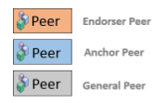
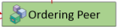

Bluebarricade Blockchain Poc Configuration overview
Org-Greenbay
Org-Music
Channel-Greenbay-network
chaincode
Channel-Music-network
…

Slide 76
Bluebarricade Blockchain POC Configuration
Blockchain Network Configuration
Blockchain Chaincode
Version - Hyperledger fabric 1.4.3
Hyperledger Composer Modeling language / Javascript
Certificate Authority configuration
We are using a single CA for poc configuration
Blockchain API Server
Datebase Type
Hyperledger Composer Rest Server
We are using couchDB 0.18 for poc configuration.
Orgs and Channels
We are using only one org and one channel called greenbay-org and greenbay-channel for poc configuration.
Ordering service
Currently we are using Solo for poc.
Peers
2 general peers, 1 endorse peer, 1 ordering peer
We are upgrading blockchain without hyperledger composer
Because Hyperledger composer is deprecated.

Slide 77
Analysis Experiences from Poc Development

Slide 78
GREENBAY CHAINCODE DESIGN
Assets
asset Address identified by address {
o String address
o String currency
o Double available_balance
o Double lock_balance
}
…
Events
event depositEvent {
--> Address to_address
o Double deposit_amount
}
event withdrawEvent {
--> Address from_address
o Double withdraw_amount
}

Slide 79
GREENBAY CHAINCODE DESIGN
Events
event transferMoneyEvent {
--> Address from
--> Address to
o Double send_amount
o Double receive_amount
}
event lockBalanceEvent {
--> Address address
o Double lock_amount
}
event unlockBalanceEvent {
--> Address address
o Double unlock_amount
}
….

Slide 80
GREENBAY CHAINCODE DESIGN
Transactions
transaction depositMoneyFromExternal {
--> Address to_address
o Double deposit_amount
}
transaction withdrawMoneyToExternal {
--> Address from_address
o Double withdraw_amount
}
transaction transferMoney {
--> Address from
--> Address to
o Double send_amount
o Double receive_amount
}
transaction lockBalance {
--> Address address
o Double lock_amount
}
transaction unlockBalance {
--> Address address
o Double unlock_amount
}
.…

Slide 81
GREENBAY BLUEBARRICADE BLOCKCHAIN APIS
getAddress
GET /v1/addresses/{address}
Parameters
Type | Name | Description | Schema
Path | address required | address | string
Responses
HTTP Code | Description | Schema
200 | OK | Address
401 | Unauthorized | No Content
403 | Forbidden | No Content
404 | Not Found | No Content

Slide 82
GREENBAY BLUEBARRICADE BLOCKCHAIN APIS
getDeposits
GET /v1/deposits
Responses
HTTP Code | Description | Schema
200 | OK | < Deposit > array
401 | Unauthorized | No Content
403 | Forbidden | No Content
HTTP Code | Description | Schema
404 | Not Found | No Content

Slide 83
GREENBAY BLUEBARRICADE BLOCKCHAIN APIS
getDeposit
GET /v1/deposits/{transactionId}
Parameters
Type | Name | Description | Schema
Path | transactionId required | transactionId | string
Responses
HTTP Code | Description | Schema
200 | OK | Deposit
401 | Unauthorized | No Content
403 | Forbidden | No Content
404 | Not Found | No Content

Slide 84
GREENBAY BLUEBARRICADE BLOCKCHAIN APIS
getLockBalances
GET /v1/lockbalances
Responses
HTTP Code | Description | Schema
200 | OK | < LockBalance > array
401 | Unauthorized | No Content
403 | Forbidden | No Content
404 | Not Found | No Content

Slide 85
GREENBAY BLUEBARRICADE BLOCKCHAIN APIS
getLockBalance
GET /v1/lockbalances/{transactionId}
Parameters
Type | Name | Description | Schema
Path | transactionId required | transactionId | string
Responses
HTTP Code | Description |  |  | Schema
200 | OK |  |  | LockBalance
HTTP Code | Description |  |  | Schema
401 | Unauthorized |  |  | No Content
403 | Forbidden |  |  | No Content
404 | Not Found |  |  | No Content

Slide 86
GREENBAY BLUEBARRICADE BLOCKCHAIN APIS
createOrder
POST /v1/order
Parameters
Type | Name | Description | Schema
Body | order required | order | Order
Responses
HTTP Code | Description | Schema
200 | OK | object
201 | Created | No Content
401 | Unauthorized | No Content
403 | Forbidden | No Content
404 | Not Found | No Content

Slide 87
GREENBAY BLUEBARRICADE BLOCKCHAIN APIS
getOrders
GET /v1/order
Parameters
Type | Name | Description | Schema
Body | order required | order | Order
Responses
HTTP Code | Description | Schema
200 | OK | string
401 | Unauthorized | No Content
403 | Forbidden | No Content
404 | Not Found | No Content

Slide 88
GREENBAY BLUEBARRICADE BLOCKCHAIN APIS
getOrder
GET /v1/order/{id}
Parameters
Type | Name | Description | Schema
Path | id required | id | string
Responses
HTTP Code | Description | Schema
200 | OK | string
401 | Unauthorized | No Content
403 | Forbidden | No Content
404 | Not Found | No Content

Slide 89
GREENBAY BLUEBARRICADE BLOCKCHAIN APIS
updateOrder
PUT /v1/order/{id}
Parameters
Type | Name | Description | Schema
Path | id required | id | string
Body | order required | order | Order
Responses
HTTP Code | Description | Schema
200 | OK | object
201 | Created | No Content
401 | Unauthorized | No Content
403 | Forbidden | No Content
404 | Not Found | No Content

Slide 90
GREENBAY BLUEBARRICADE BLOCKCHAIN APIS
deleteOrder
DELETE /v1/order/{id}
Parameters
Type | Name | Description | Schema
Path | id required | id | string
Responses
HTTP Code | Description | Schema
200 | OK | string
204 | No Content | No Content
HTTP Code | Description | Schema
401 | Unauthorized | No Content
403 | Forbidden | No Content

Slide 91
GREENBAY BLUEBARRICADE BLOCKCHAIN APIS
deleteOrder
GET /v1/transfers
Responses
HTTP Code | Description | Schema
200 | OK | < Transfer > array
401 | Unauthorized | No Content
403 | Forbidden | No Content
404 | Not Found | No Content

Slide 92
GREENBAY BLUEBARRICADE BLOCKCHAIN APIS
getTransfers
GET /v1/transfers
Responses
HTTP Code | Description | Schema
200 | OK | < Transfer > array
401 | Unauthorized | No Content
403 | Forbidden | No Content
404 | Not Found | No Content

Slide 93
GREENBAY BLUEBARRICADE BLOCKCHAIN APIS
getTransfer
GET /v1/transfers/{transactionId}
Parameters
Type | Name | Description | Schema
Path | transactionId required | transactionId | string
Responses
HTTP Code | Description | Schema
200 | OK | Transfer
401 | Unauthorized | No Content
403 | Forbidden | No Content
404 | Not Found | No Content

Slide 94
GREENBAY BLUEBARRICADE BLOCKCHAIN APIS
getUnlockBalance
GET /v1/unlockbalances
Responses
HTTP Code | Description | Schema
200 | OK | < UnlockBalance > array
401 | Unauthorized | No Content
403 | Forbidden | No Content
404 | Not Found | No Content

Slide 95
GREENBAY BLUEBARRICADE BLOCKCHAIN APIS
getTransfer
GET /v1/unlockbalances/{transactionId}
Parameters
Type | Name | Description | Schema
Path | transactionId required | transactionId | string
Responses
HTTP Code | Description | Schema
200 | OK | UnlockBalance
401 | Unauthorized | No Content
403 | Forbidden | No Content
404 | Not Found | No Content

Slide 96
GREENBAY BLUEBARRICADE BLOCKCHAIN APIS
getWithdraws
GET /v1/withdraws
Responses
HTTP Code | Description | Schema
200 | OK | < Withdraw array | >
401 | Unauthorized | No Content
403 | Forbidden | No Content
404 | Not Found | No Content

Slide 97
GREENBAY BLUEBARRICADE BLOCKCHAIN APIS
getWithdraw
GET /v1/withdraws/{transactionId}
Parameters
Type | Name | Description | Schema
Path | transactionId required | transactionId | string
Responses
HTTP Code | Description | Schema
200 | OK | Withdraw
401 | Unauthorized | No Content
403 | Forbidden | No Content
404 | Not Found | No Content

Slide 98
E-Wallet

Slide 99
What is E-Wallet
First time it is a sub module of Greenbay, but now it is standalone FinTech service API which provides several way to deposit, withdraw and transfer
Now Greenbay is an example which uses E-Wallet service.
B2B service model.
Integrated with blockchain
Simple & Scalable
Functions
Authentication
Wallet
Address
Payment
Transactions
Currency

Slide 100
Architecture
Payment Gateways
(Paypal, Stripe, Openbank etc…)
Client
Platform
E-Wallet
APIs
(NodeJS + Express)
Client
Platform
Bluebarricade
Blockchain
Client
Platform
DB2

Slide 101
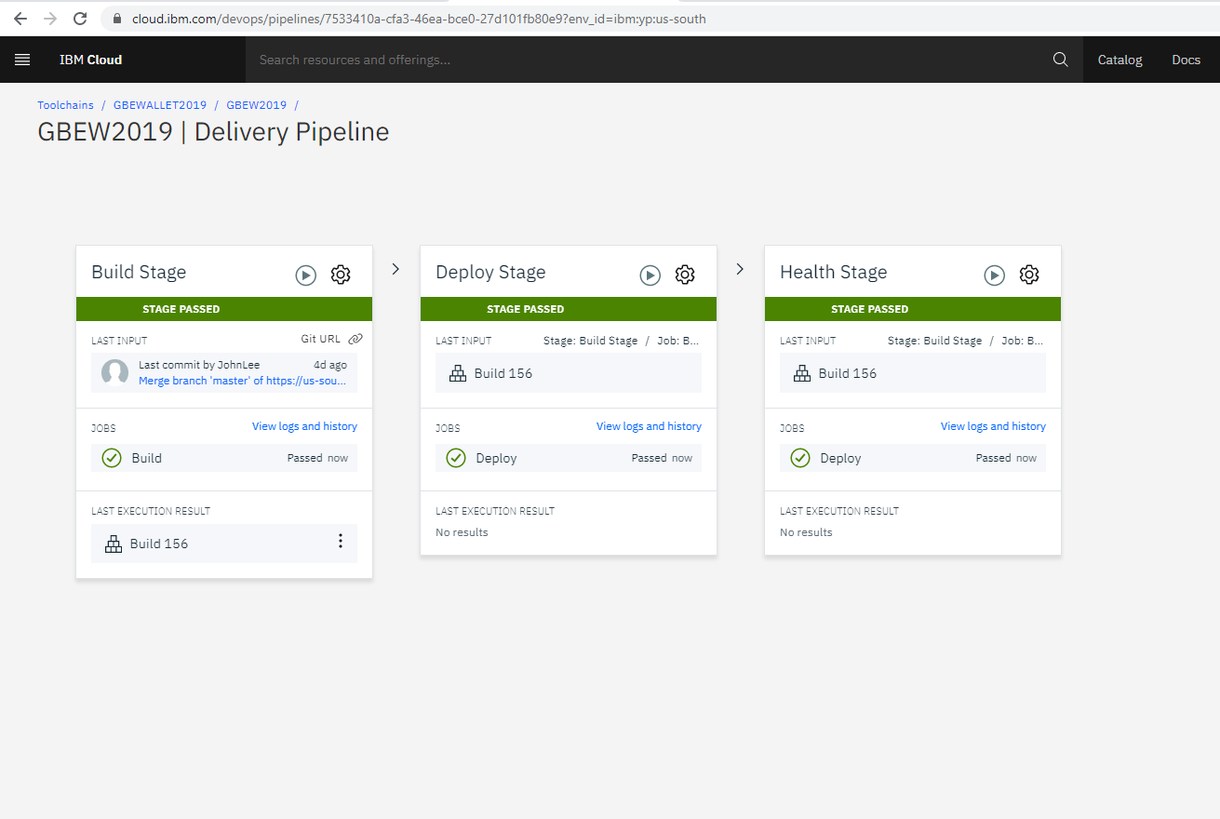
CI/CD
Setup toolchain on IBM cloud console

Slide 102
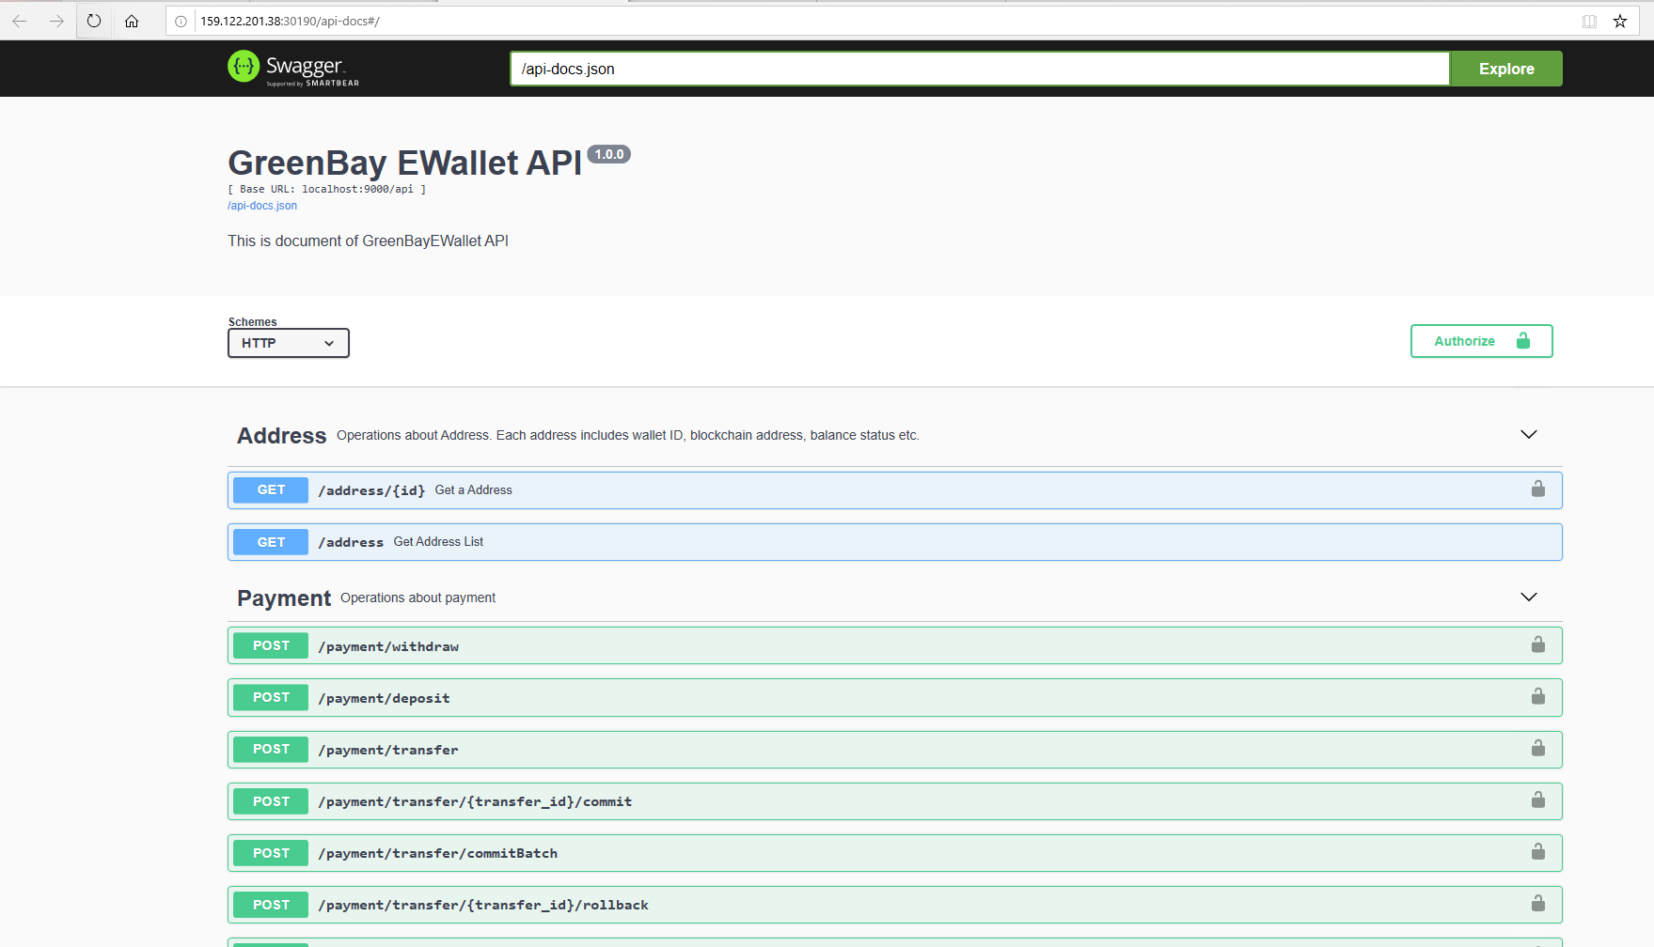
API Documenation
http://159.122.201.38:30190/api-docs#/

Slide 103
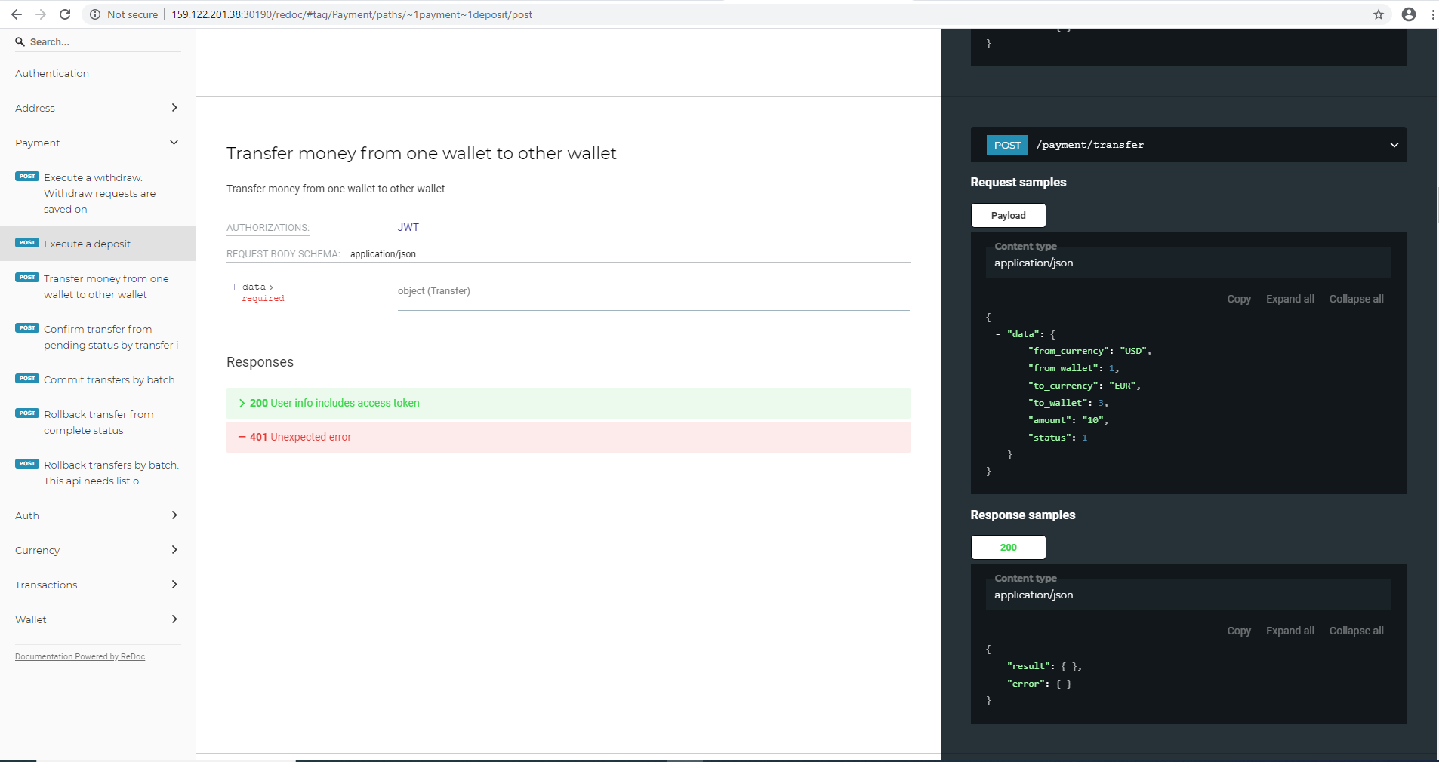
API Documenation
http://159.122.201.38:30190/redoc

Slide 104
Greenbay

Slide 105
What is Greenbay
B2C Payment Gateway system using Bluebarricade Blockchain and E-Wallet service

Slide 106
Sub systems
Greenbay has several sub systems to attract more users into greenbay system.
Greenbay Donation
Greenbay Transfer
Greenbay Project
Greenbay Payment

Slide 107
Sub Systems
AWS
IBM/HCL
IBM/HCL
IBM/HCL
Greenbay
Donation
(web, Mobile)
Greenbay
Transfer
(Web, Mobile)
Greenbay
Backend
E-Wallet
Service
Bluebarricade
Blockchain
Greenbay
Project
(web)
Greenbay
Payment
(web)

Slide 108
Greenbay Backend
Payment/Donation API service on greenbay user platform
Using E-wallet service so that all transactions and wallets synchronized in bluebarricade blockchain
Nodejs + Express
DB2
E-Wallet
Bluebarricade Blockchain
API Modules
Auth
User
Group
Project
Donate
Currency
Wallet
Transaction
Payment

Slide 109
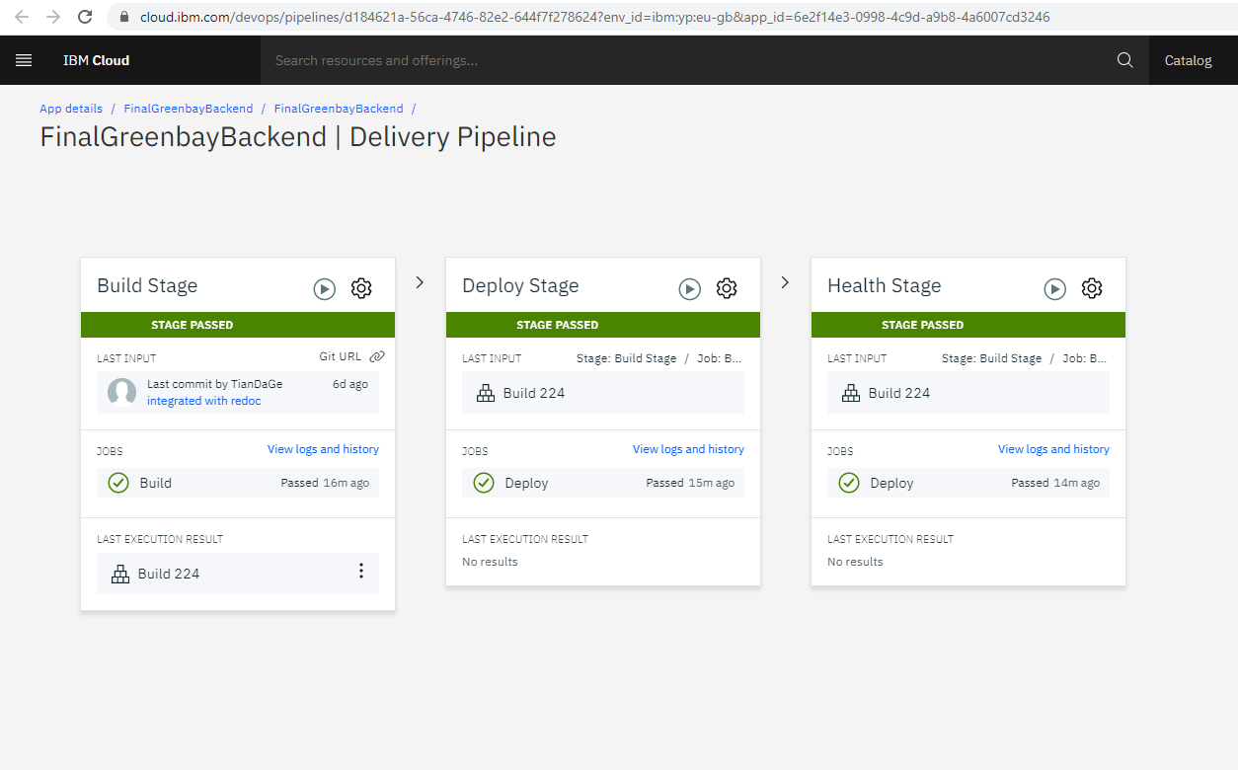
Greenbay Backend on IBM Cloud
Setup toolchain on IBM cloud console

Slide 110
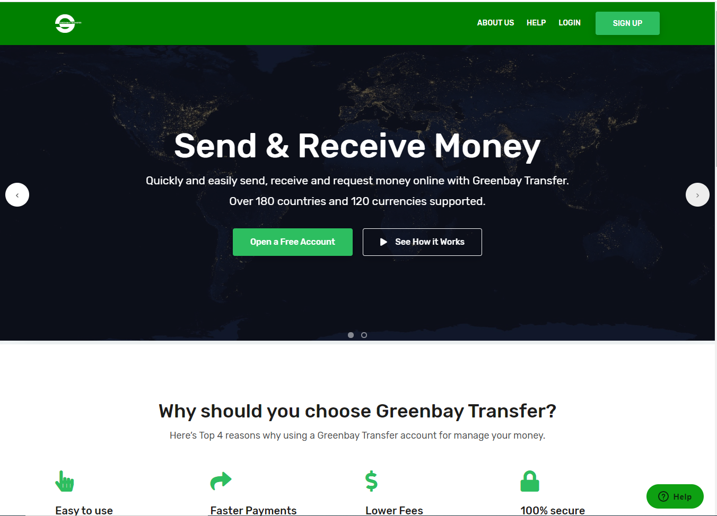
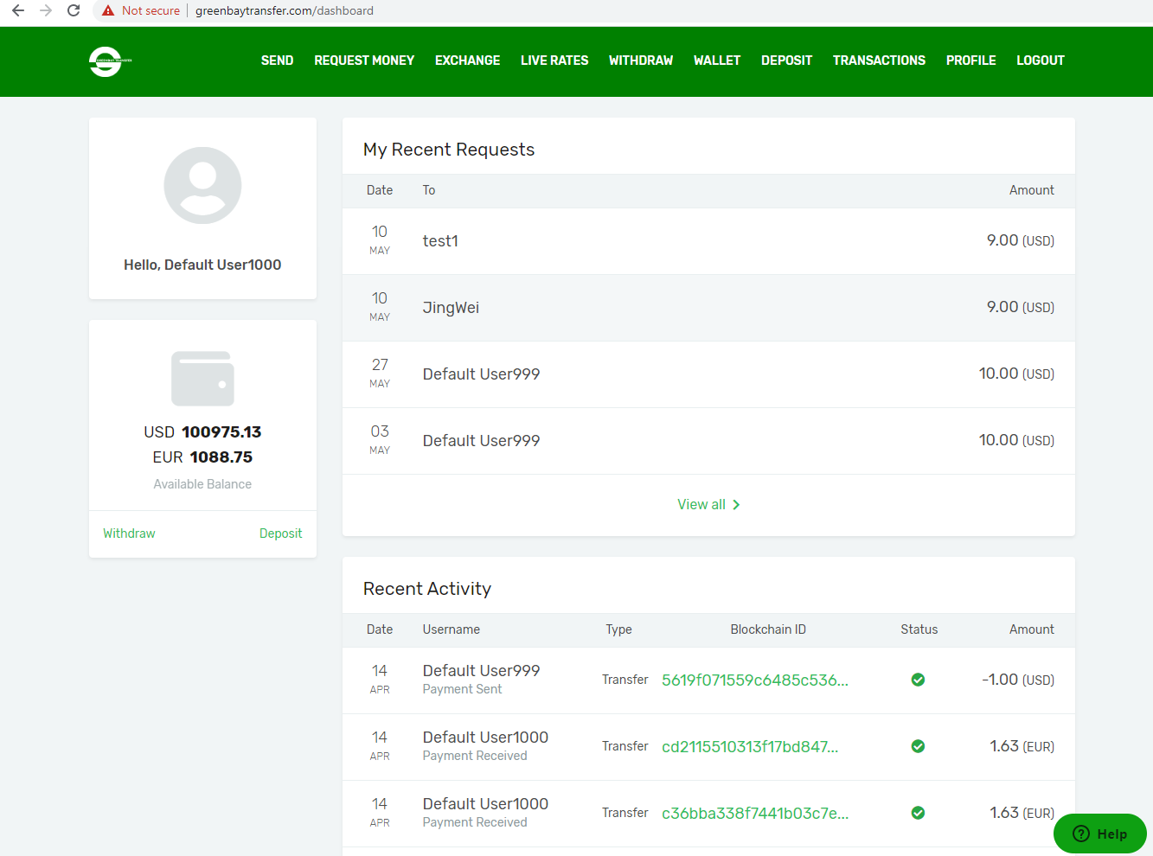
GreenbayTransfer
http://greenbaytransfer.com/

Slide 111
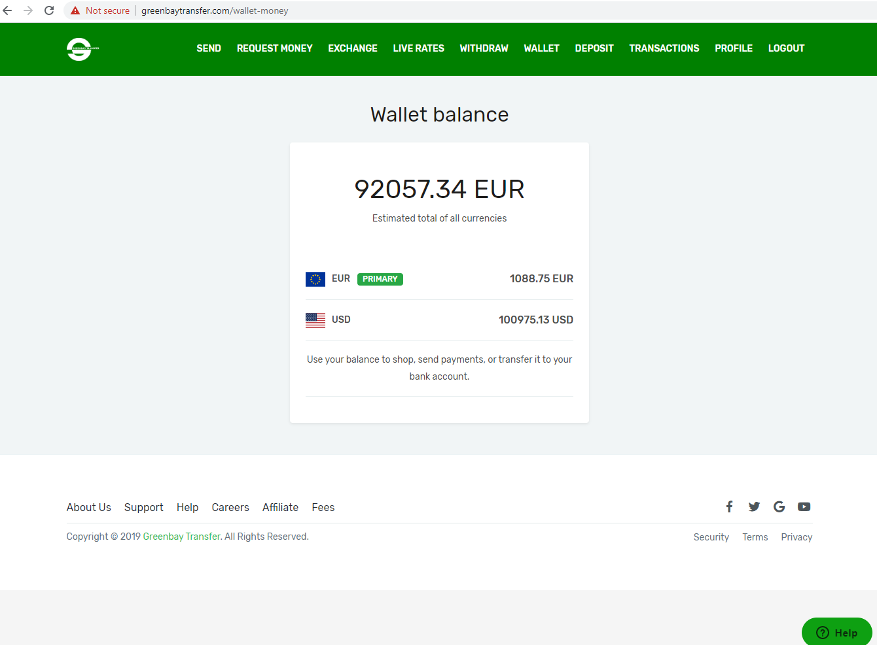
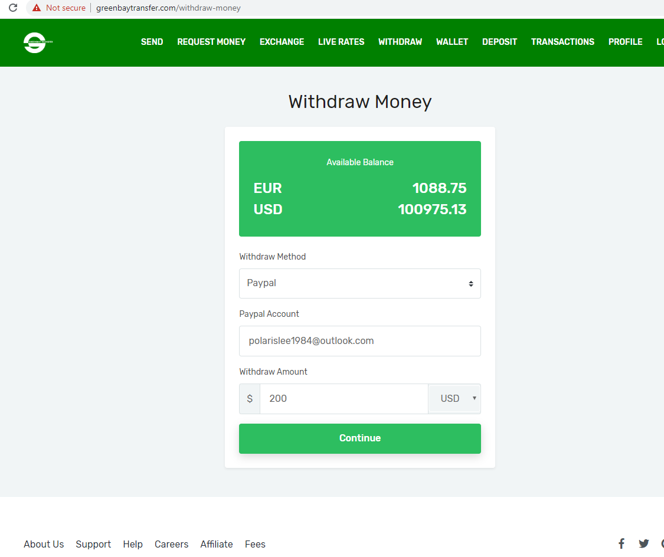
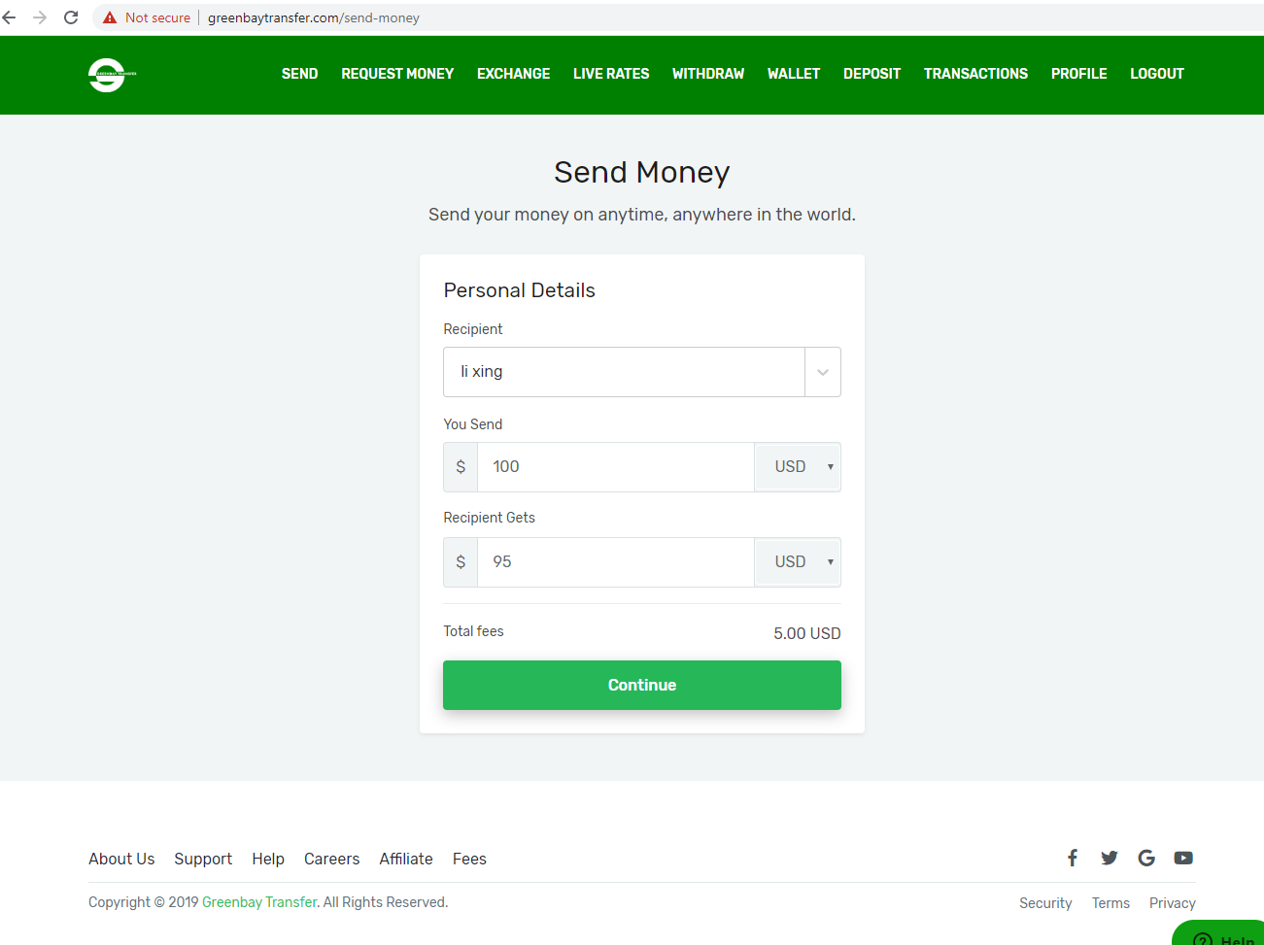
GreenbayTransfer

Slide 112
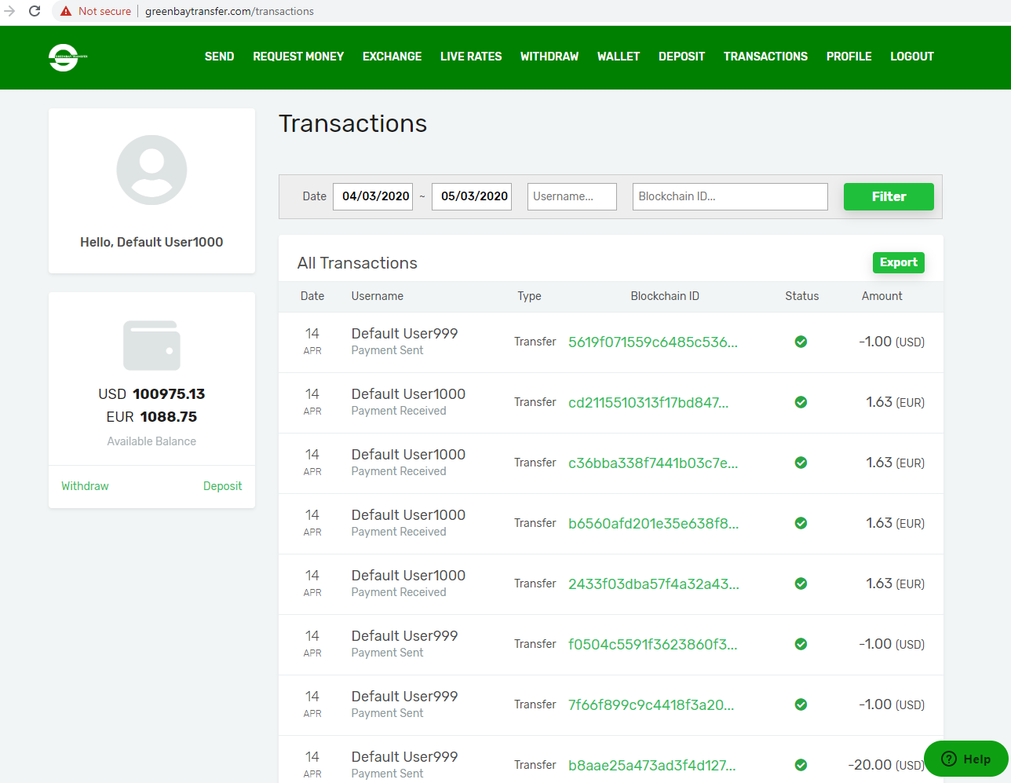
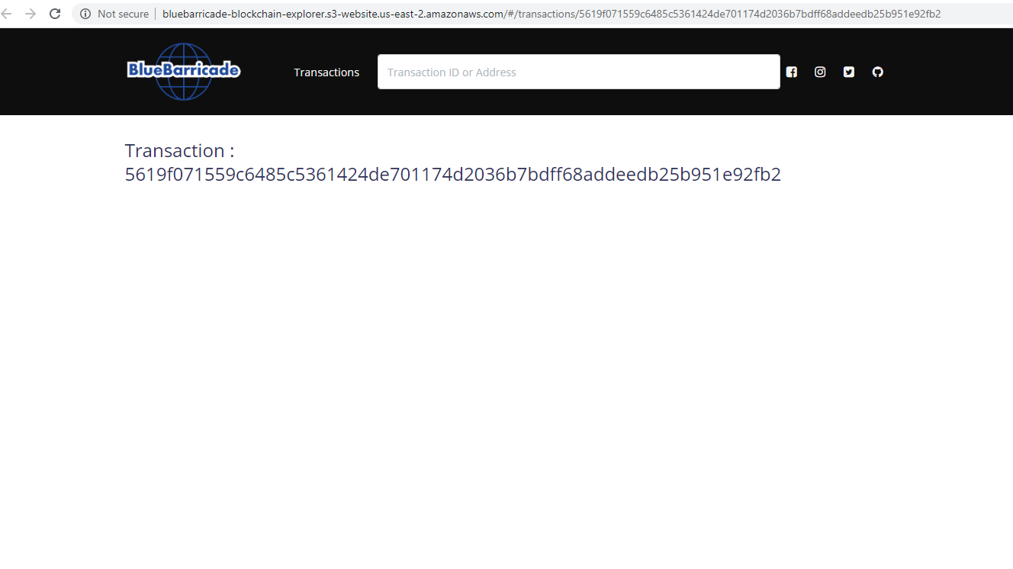
GreenbayTransfer

Slide 113
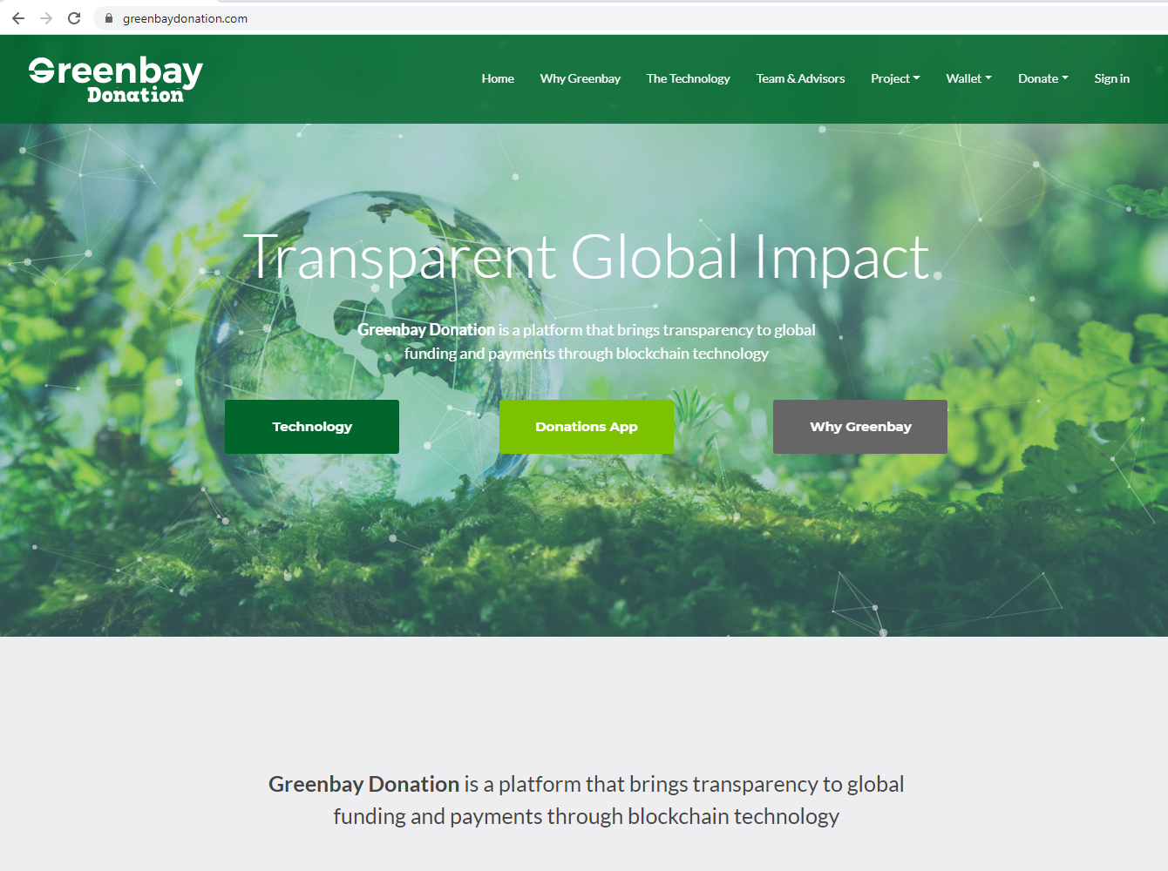
GreenbayDonation
https://greenbaydonation.com

Slide 114
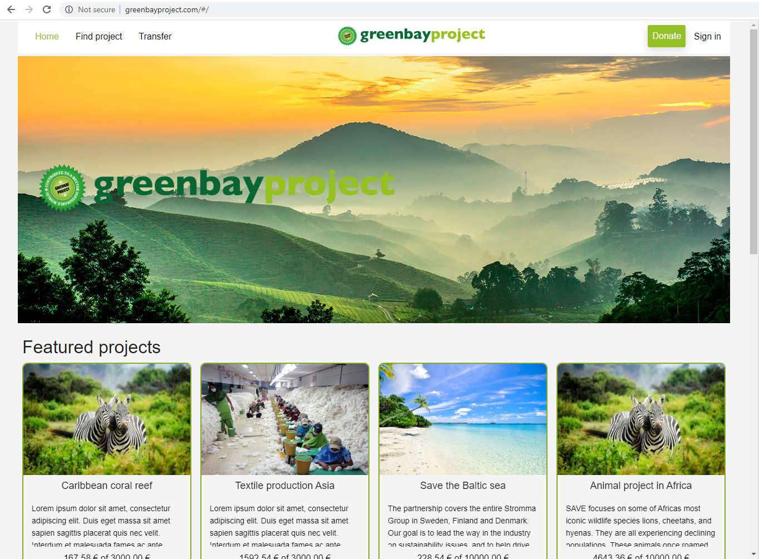
GreenbayPayment
https://greenbaypayment.com

Slide 115
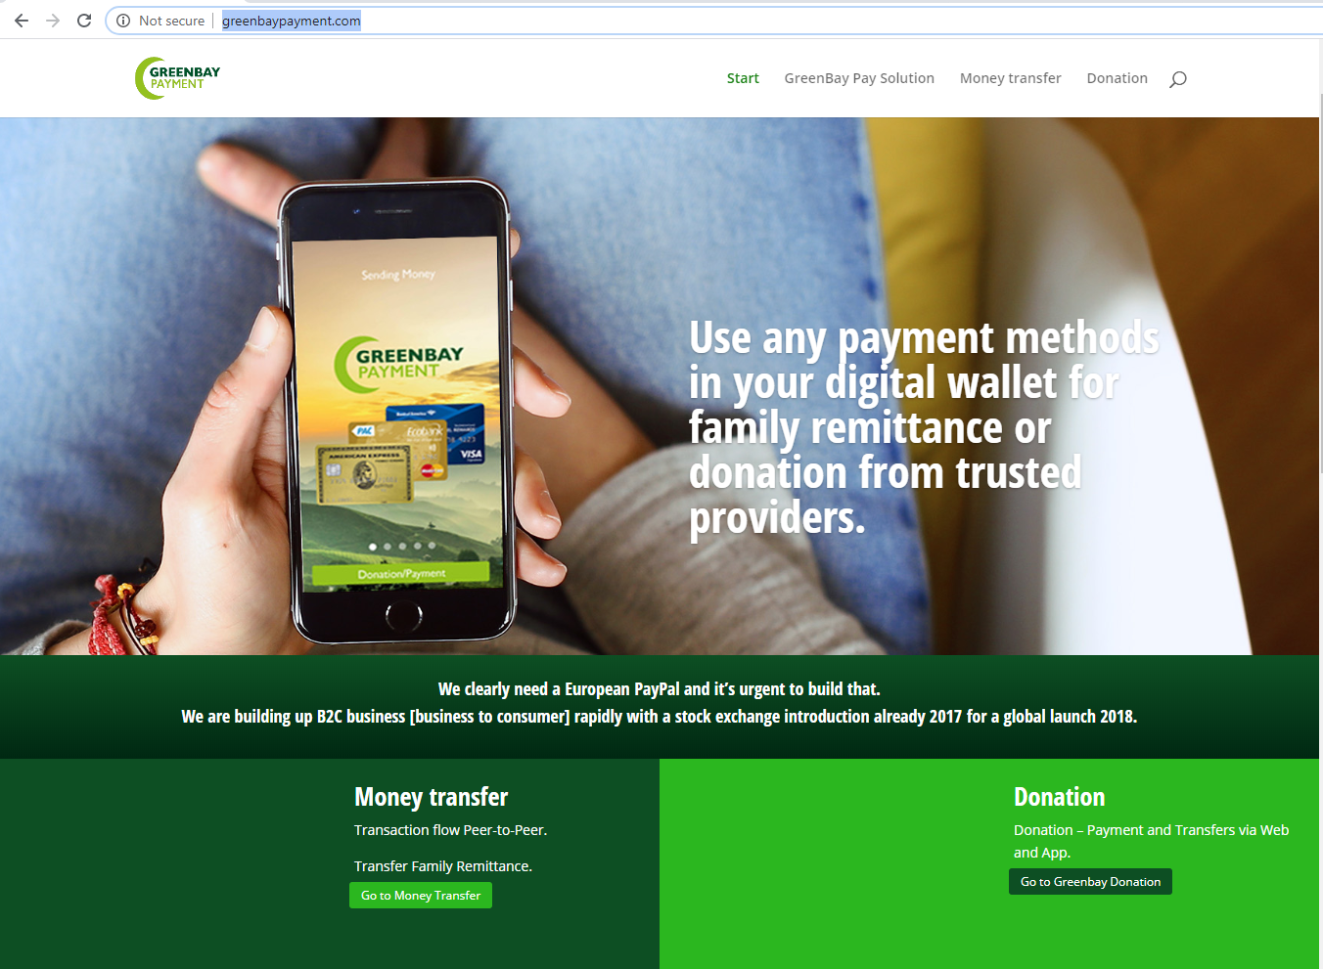
GreenbayPayment
https://greenbaypayment.com

Slide 116
Greenbay Transfer Admin Panel

Slide 117
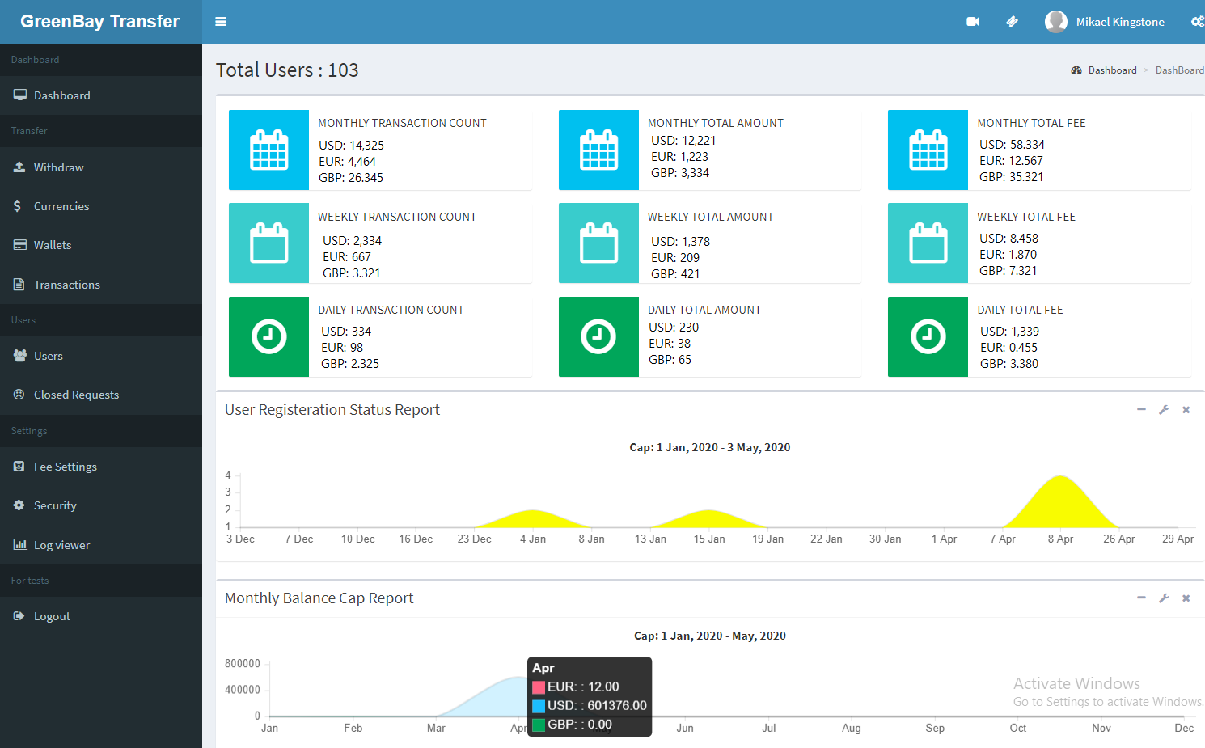
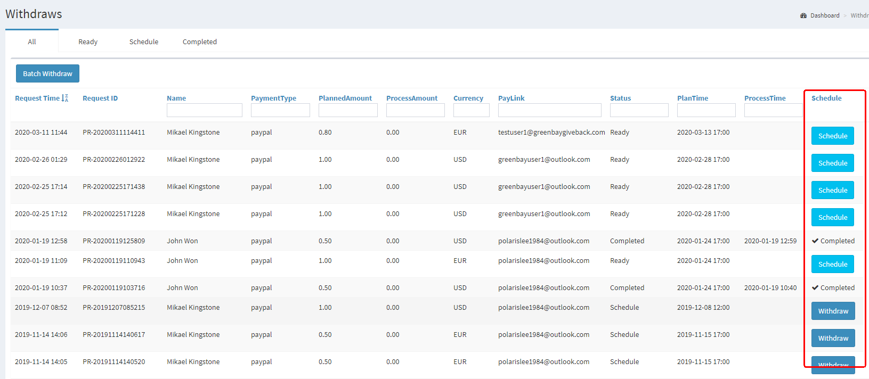
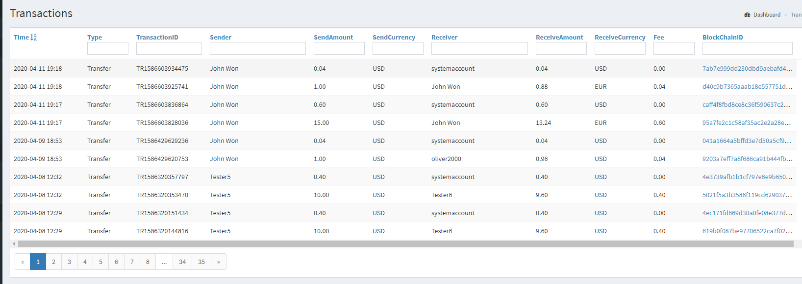
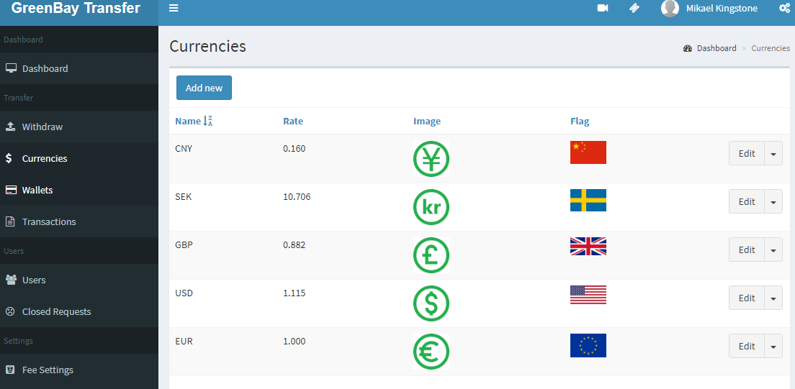
Greenbay Transfer Admin Panel

Slide 118
Greenbay Transfer Admin Panel
Dashboard Page
www.greenbaytransfer.com
Wallet Page
Withdraw Page
IBM (HCL) DB 2
Greenbay Back end
Transaction Page
Currency Page
Fee Setting Page
Closed Request Page
User Page
Greenbay EWallet
Admin Panel

Slide 119
Greenbay Donation Admin Panel

Slide 120
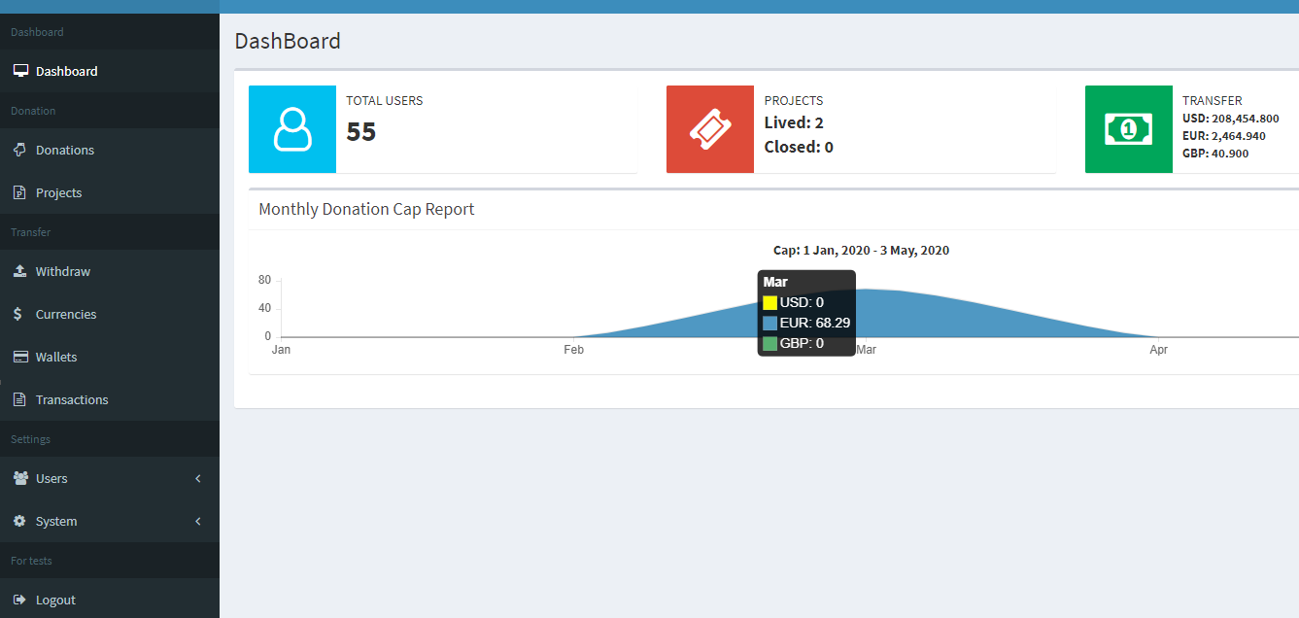
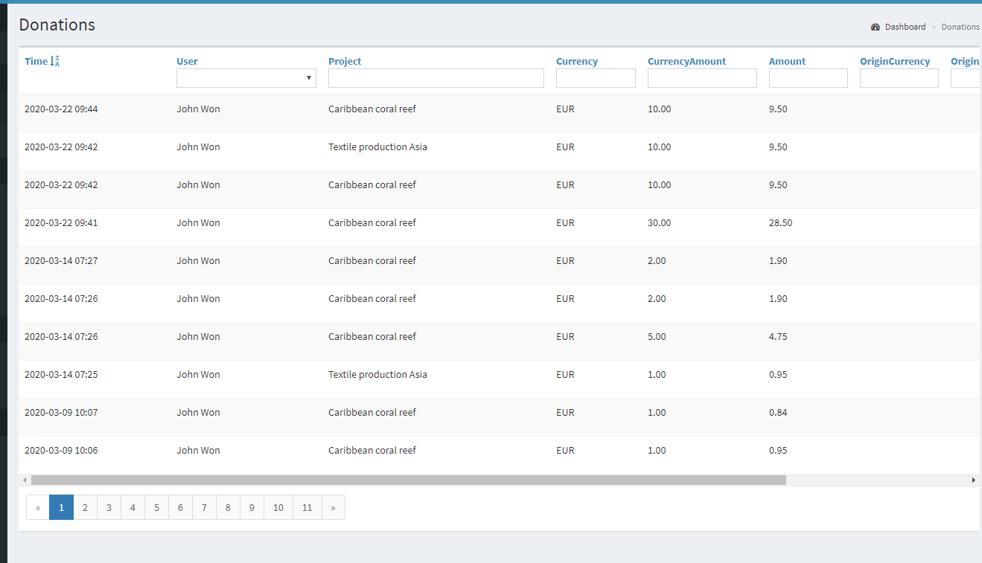
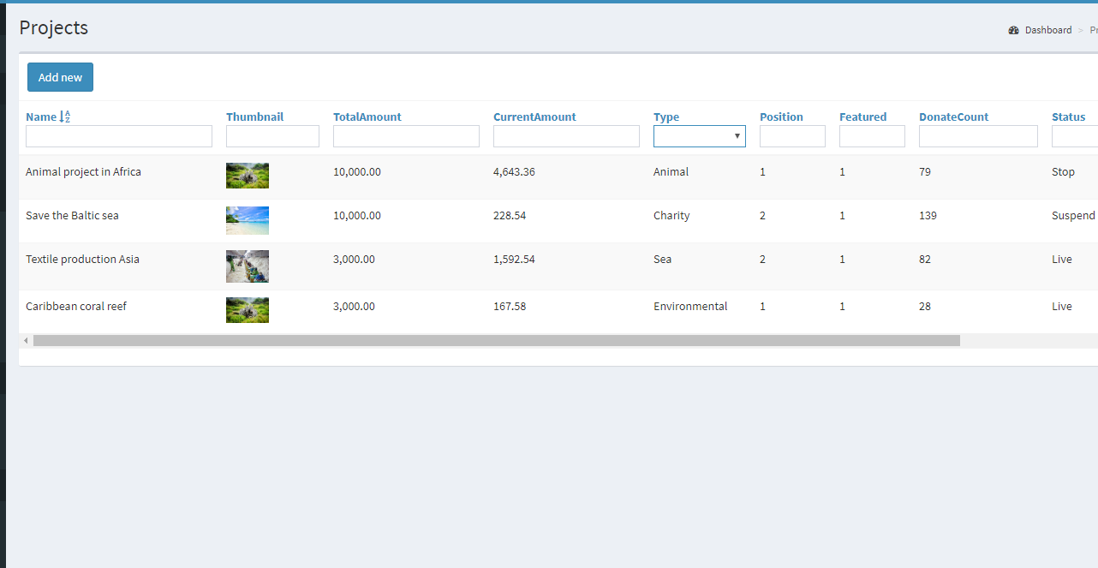
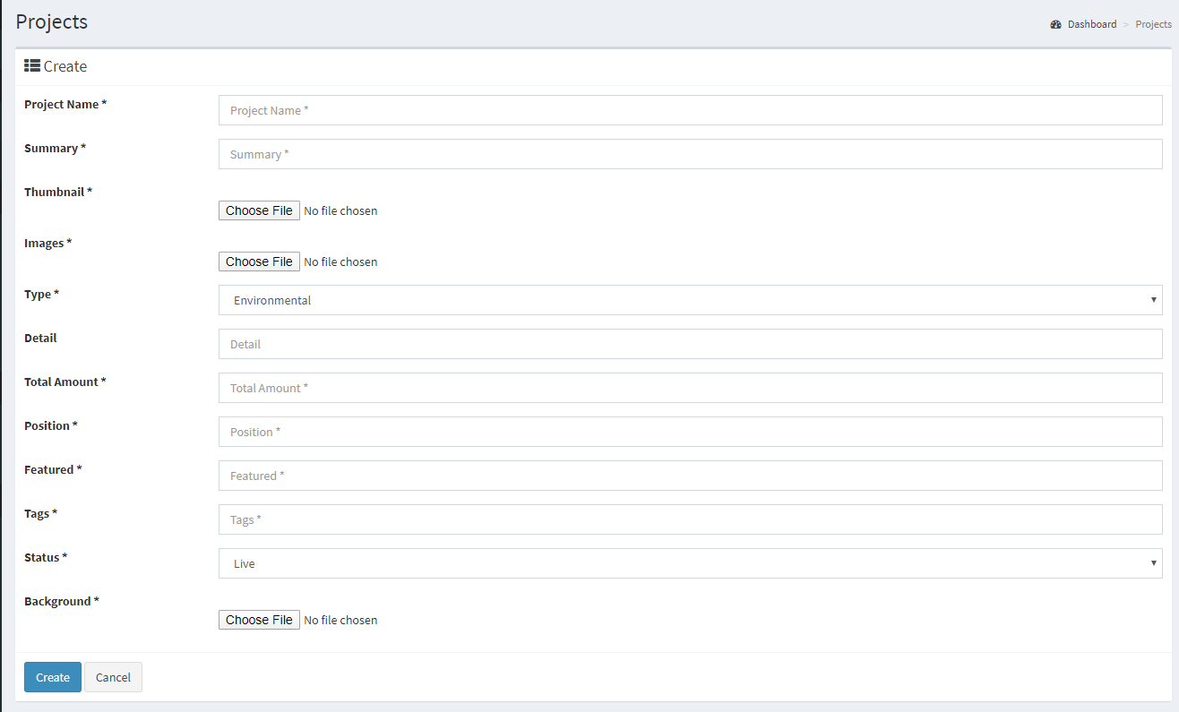
Greenbay Donation Admin Panel

Slide 121
Greenbay Donation Admin Panel
Dashboard Page
www.greenbaytransfer.com
Project Page
Donation Page
IBM (HCL) DB 2
Greenbay Back end
Withdraw Page
Currency Page
Wallet Page
Transaction Page
User Page
Greenbay EWallet
Admin Panel

Slide 122
Blockchain Explorer

Slide 123
What is Blockchain Explorer
First time it is a sub module of Greenbay, but now it is standalone FinTech service API which provides several way to deposit, withdraw and transfer
Now Greenbay is an example which used E-Wallet service.
B2B service model.
Integrated with blockchain
Simple & Scalable
Functions
Authentication
Wallet
Address
Payment
Transactions
Currency

Slide 124
Testing

Slide 125
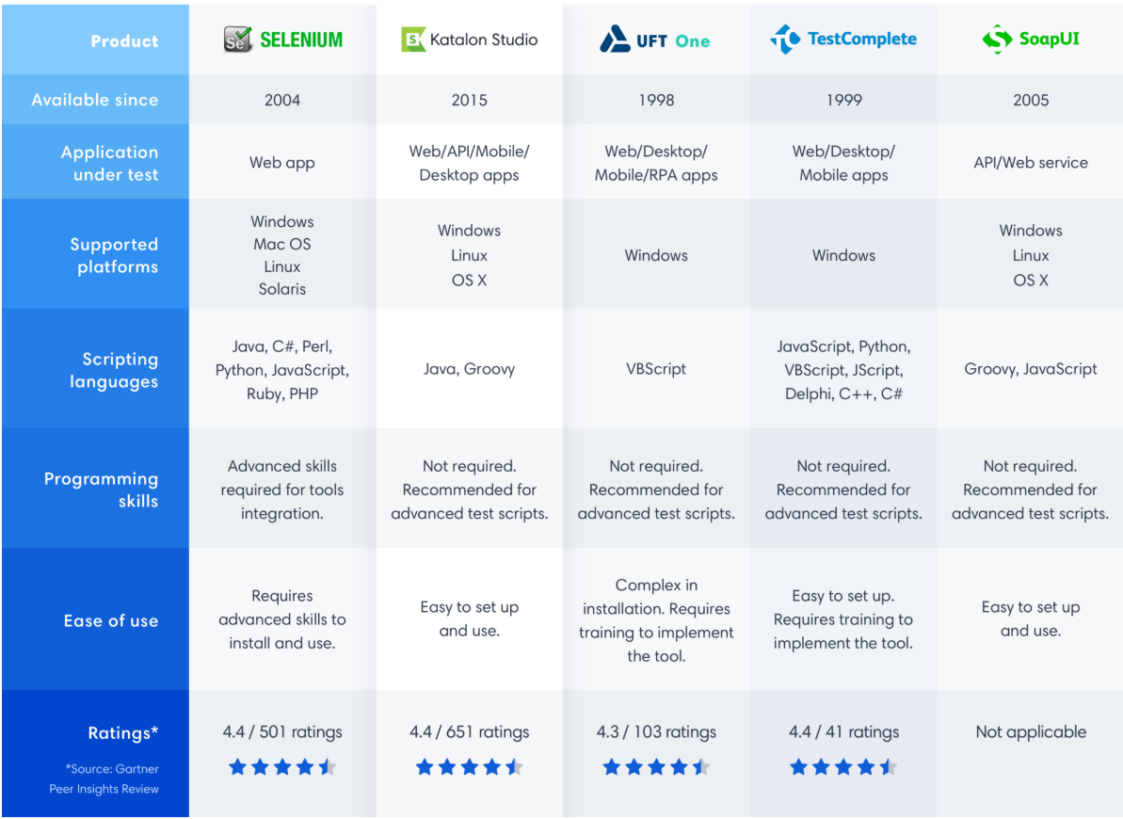
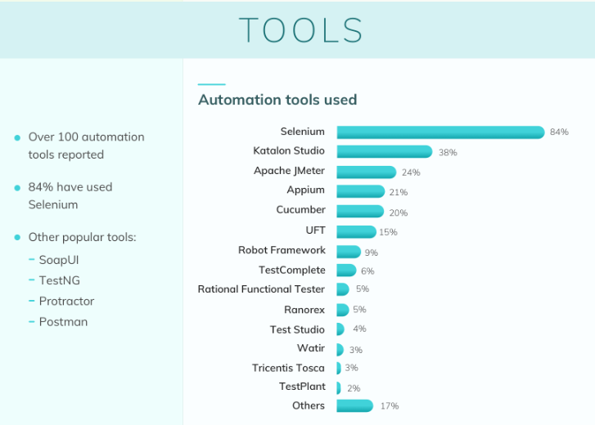
Website Automation Testing
Why selenium?
Good rating
Cross-Platform
Supports several languages
Ever used
Easy to use
Free

Slide 126
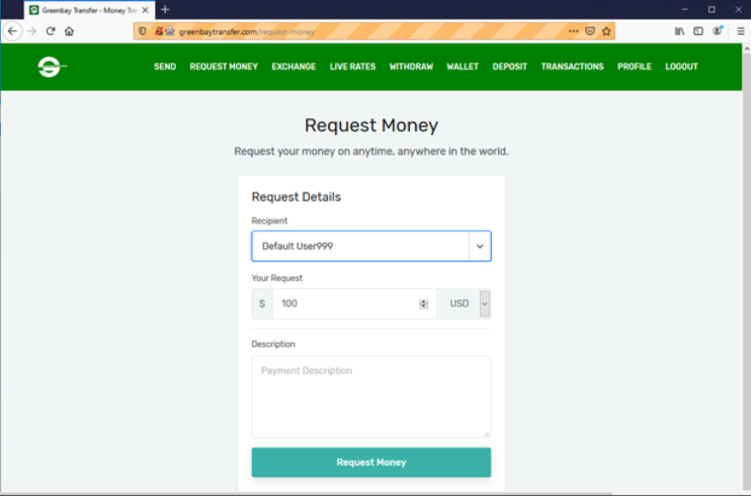
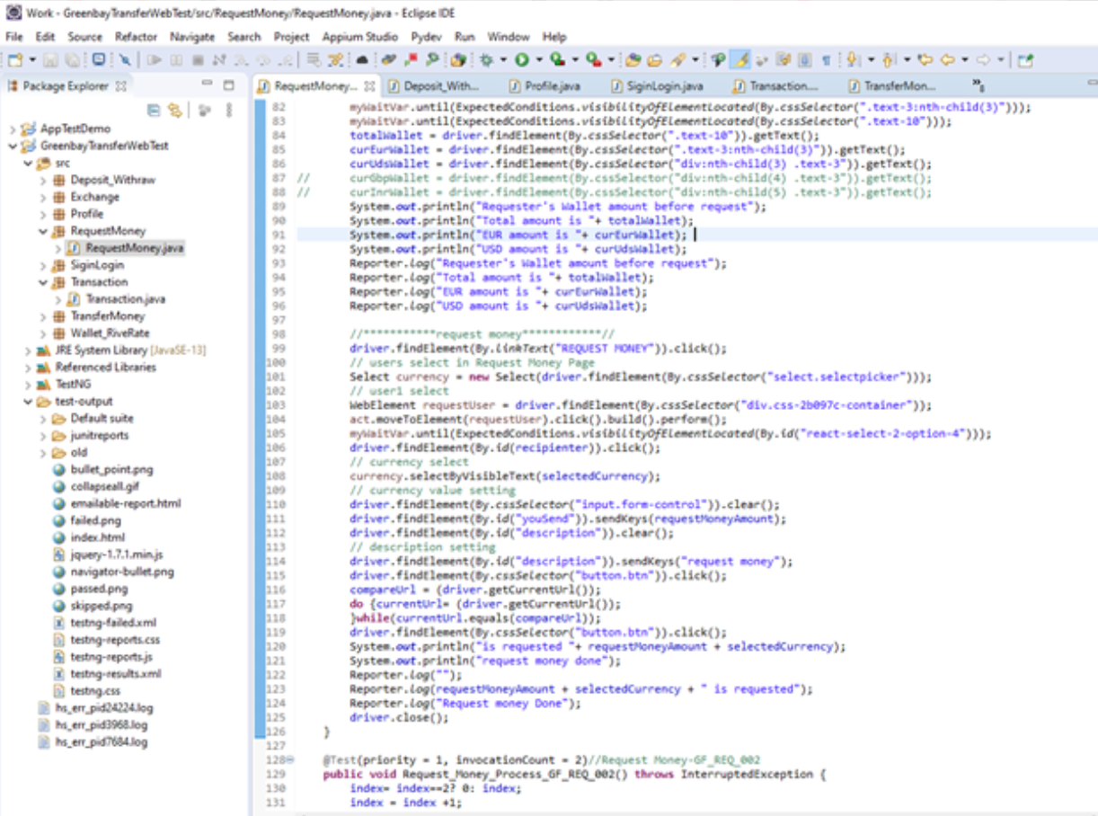
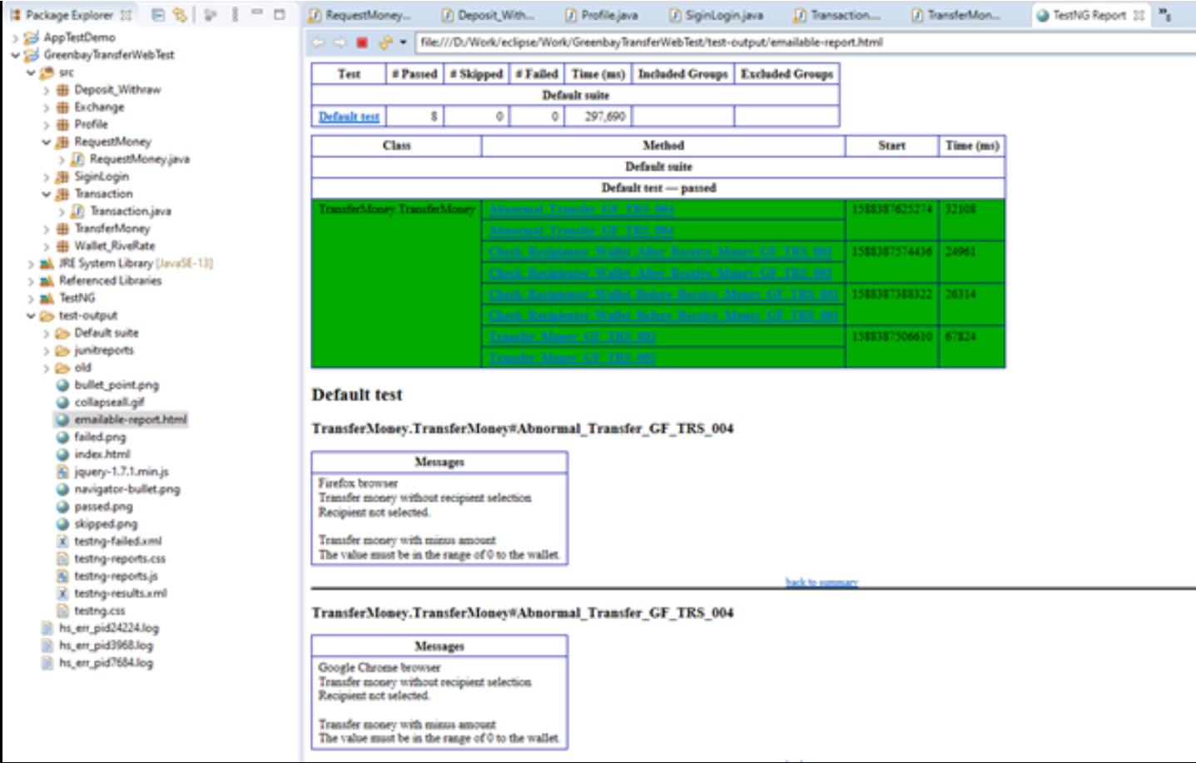
Greenbay Testing using Selenium
Web Automation Testing using Selenium
1
2
3

Slide 127
Mobile Automation Testing
Why Appium?
Appium is an open source automation tool for running scripts and testing native applications, mobile-web applications and hybrid applications on Android or iOS using a webdriver
Most popular
Cross-Platform
Supports several languages
Easy to use
Open Source

Slide 128
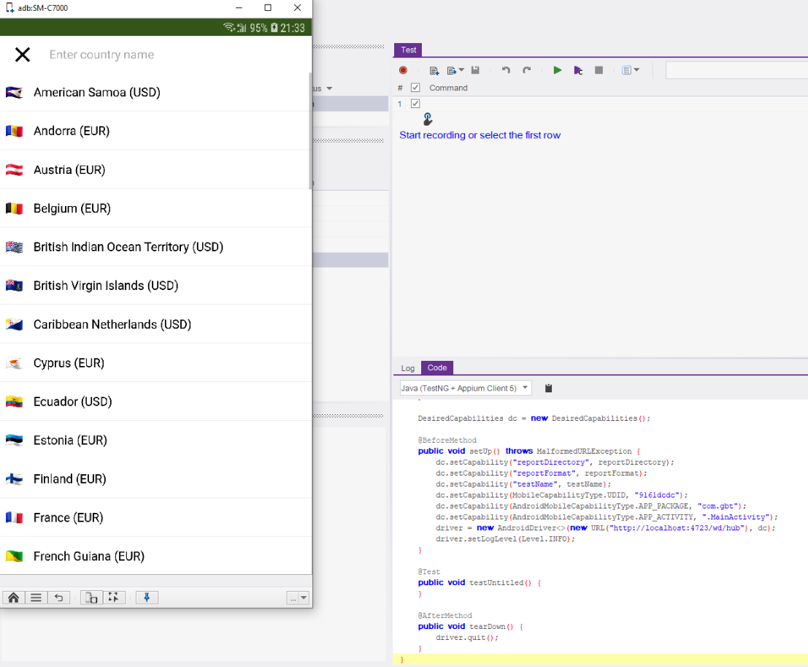
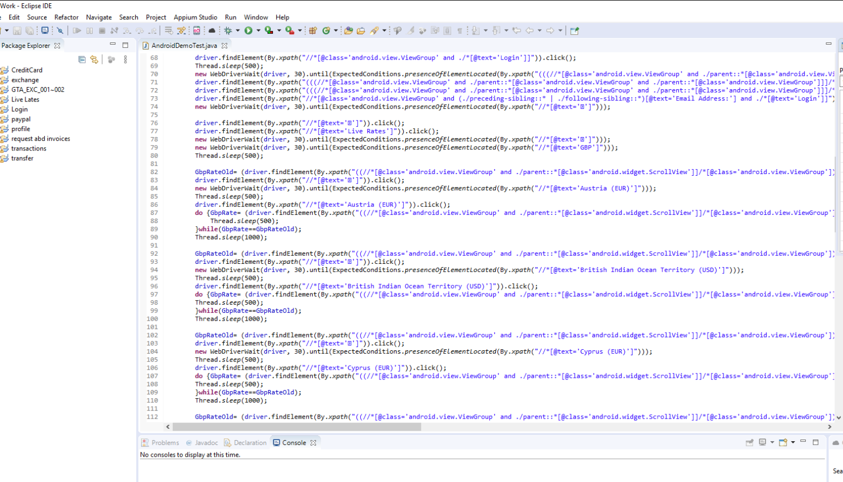
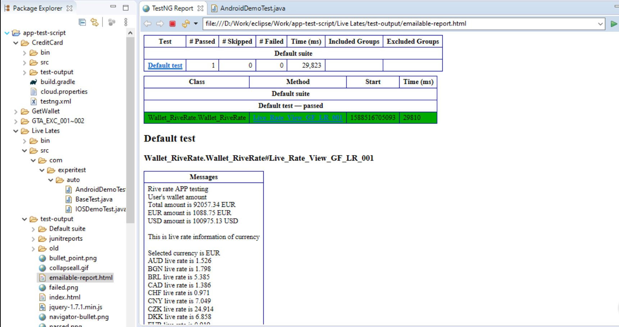
Greenbay Mobile Testing using Appium
1
Mobile Automation Testing using Appium

Slide 129
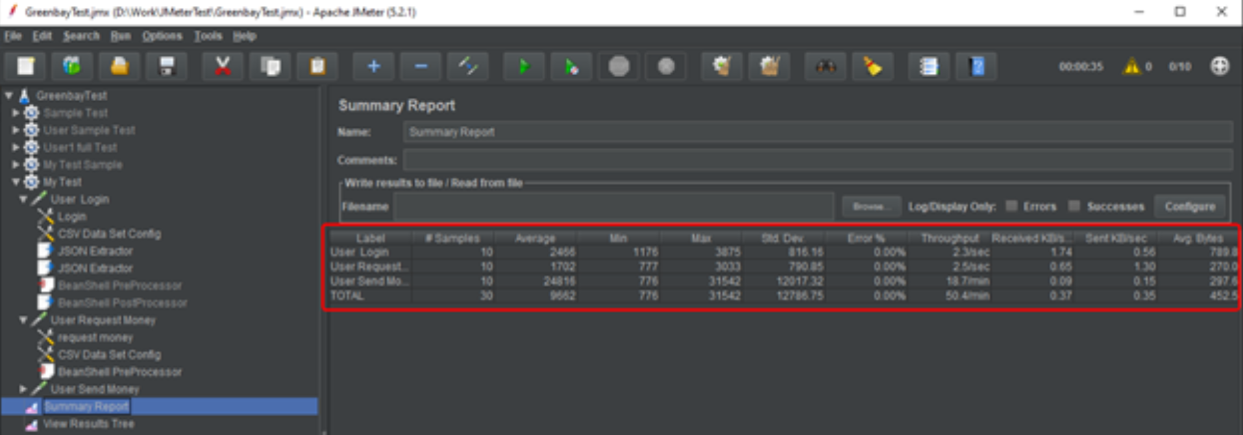
API Testing
API performance testing using jMeter
Highlights of the tool include:
Lightweight with a simple and easy-to-use user interface
Test results can be replayed
Support CSV files to set values for API parameters
Support integration with CI tools such as Jenkins. JMeter is often used as a part of CI and DevOps toolchains

